Slide 1
Transforming ∆ into α:
The Macro Trends Shaping the Future of Business & Real Estate
March 18 | Detroit
Bret Swango, CFA
SVP – Head of Location Intelligence & Workforce Analytics

Slide 2
Agenda
Introduction
Macro Context
The Forces Shaping the Future
Examples of Transforming ∆ into α

Slide 3
“The most dangerous thing in business is finding the right answer to the wrong question.”
- Peter Drucker

Slide 4
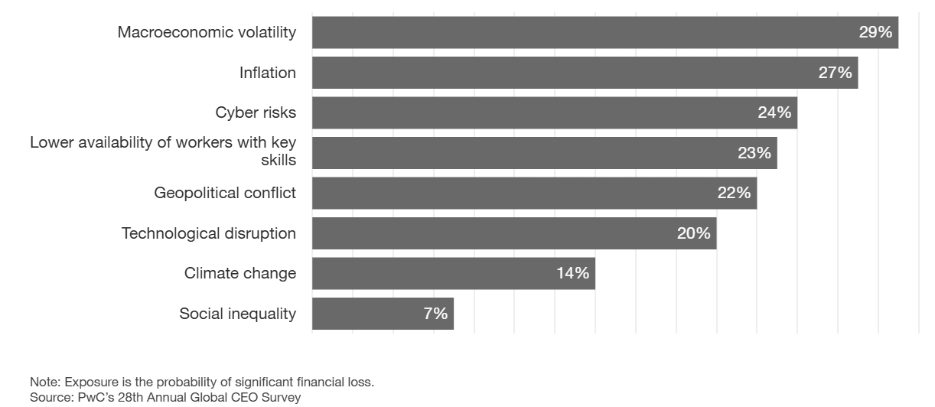
Macroeconomic volatility and inflation are key concerns of CEOs
CEO Survey Response: “How exposed do you believe your company will be to the following key threats in the next 12 months?”

Slide 5
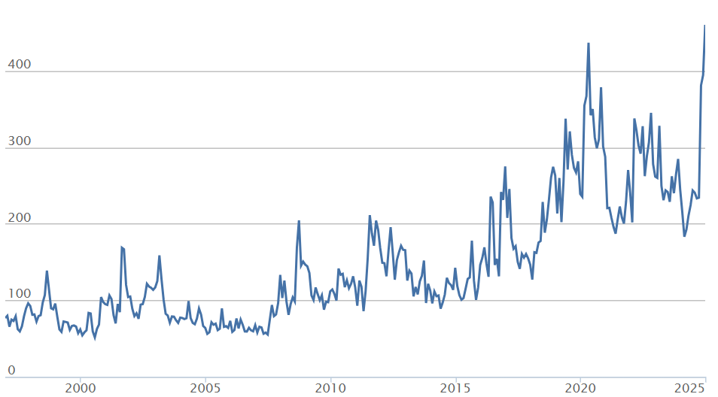
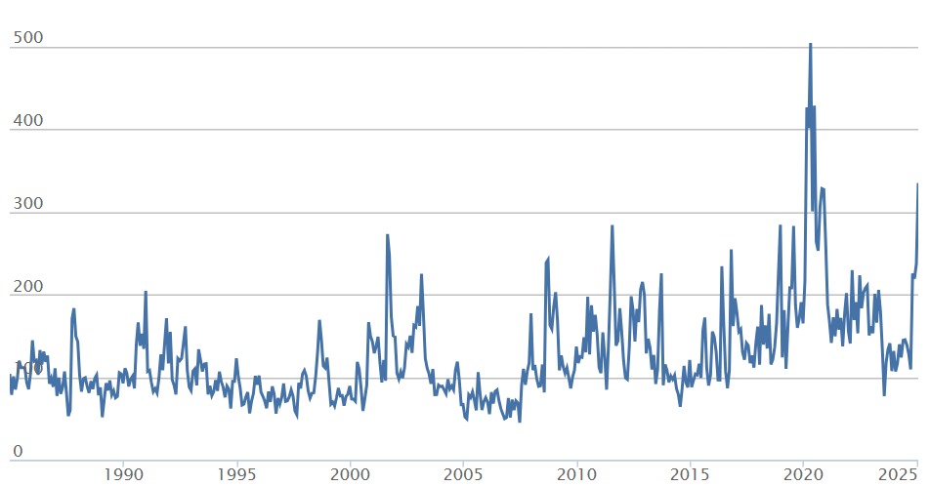
Uncertainty is the “New Normal”
Global Economic Policy Uncertainty
U.S. Economic Policy Uncertainty
Source: Economic Policy Uncertainty Index

Slide 6
“The gap between the markets’ solutions and technology’s current capabilities to solve those problems more effectively has never been greater…
Within that gap lies unprecedented opportunity.”
- Unknown

Slide 7






The Big Shifts
Higher for Longer Interest Rates
Deglobalization
∆
The AI Revolution
Inflationary
Deflationary
Green Transition
Shifting Demographics

Slide 8


The AI Revolution
8
"AI could have implications for humanity that are more profound than electricity or fire.“
- Sundar Pichai, Alphabet CEO

Slide 9
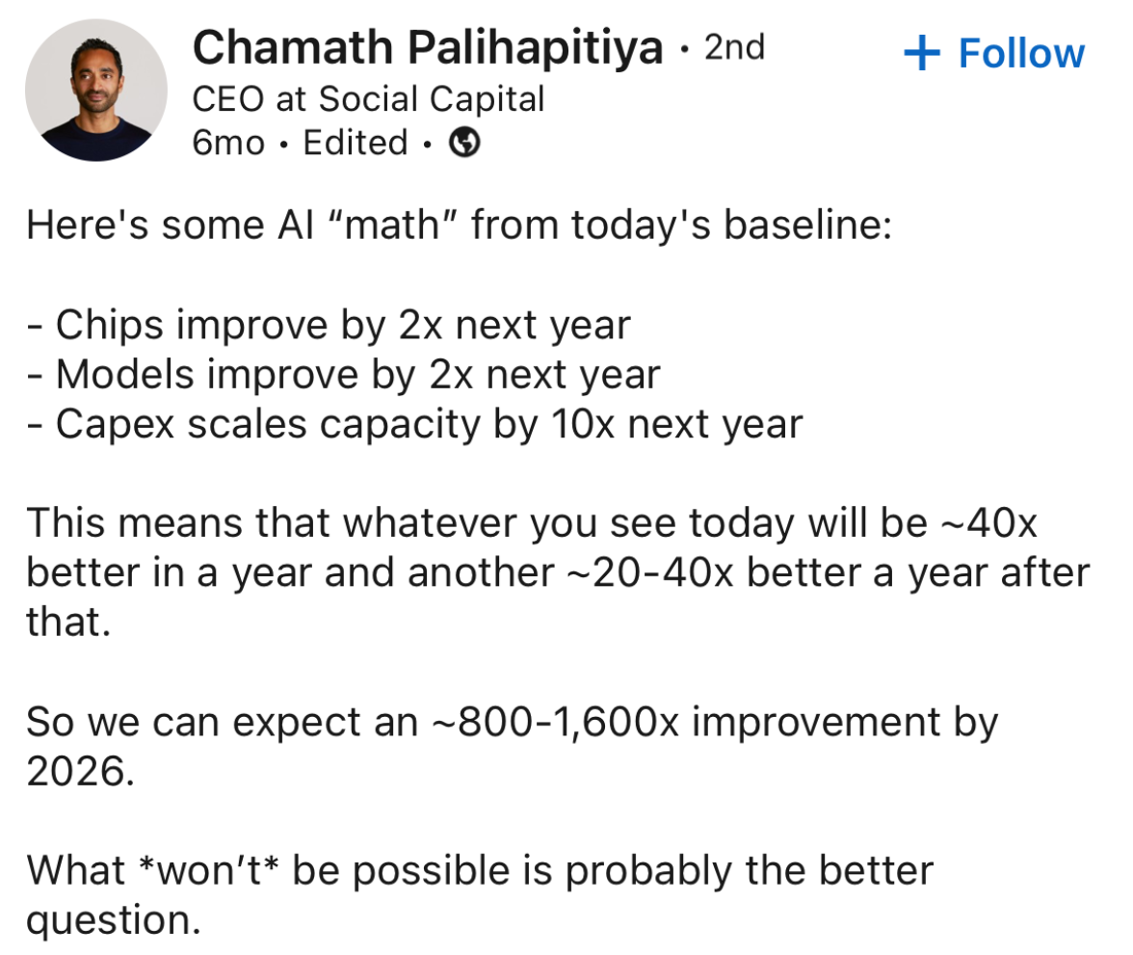
AI is scaling in a non-linear manner
"I think we really are on the edge of probably the biggest technology revolution that has ever existed…. The artificial intelligence compute coming online appears to be increasing by a factor of 10 every six months.”
- Elon Musk

Slide 10
The pace of scaling in AI in historically unprecedented
AI's coding ability increase
Drug target hypothesis testing
Source: Ark Invest
Source: Ark Invest

Slide 11
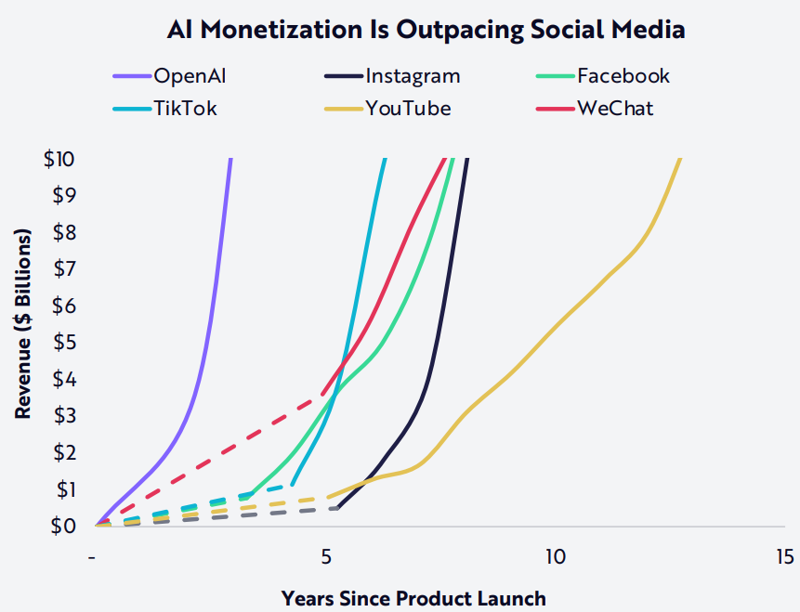
The pace of scaling in AI in historically unprecedented
Source: Ark Invest

Slide 12
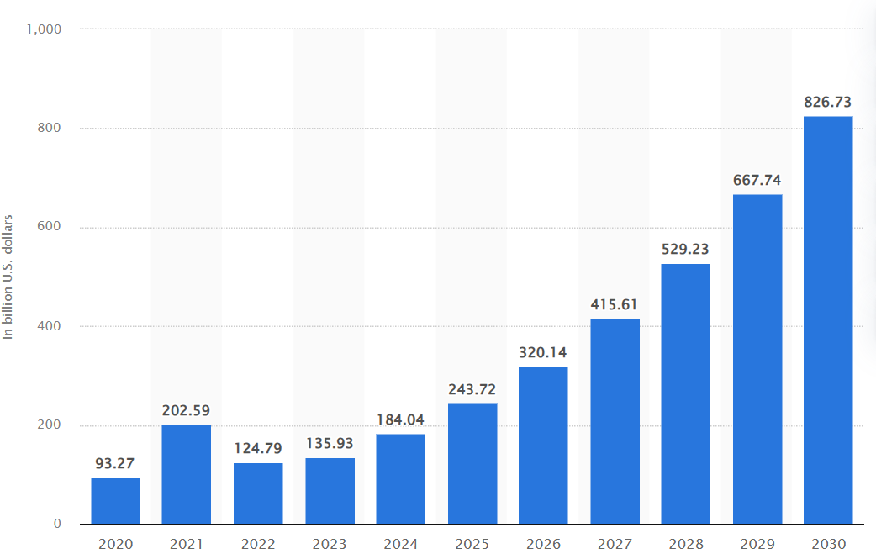
The global market for AI is exploding
Value of the Global AI Market in $ Billions
Source: Statista

Slide 13
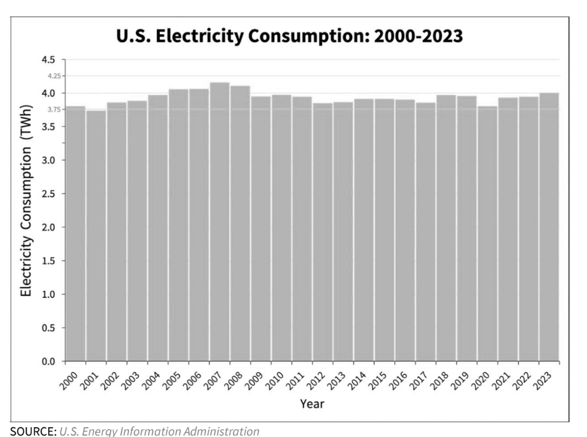
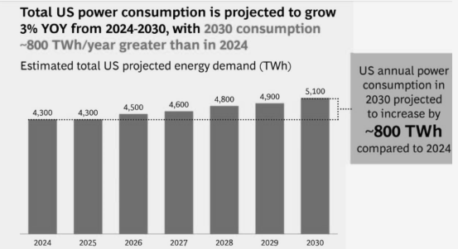
Power demand is expected to grow between 3-6x over the next 6 years relative to what it has since 2000
Source: U.S. Energy Information Administration

Slide 14
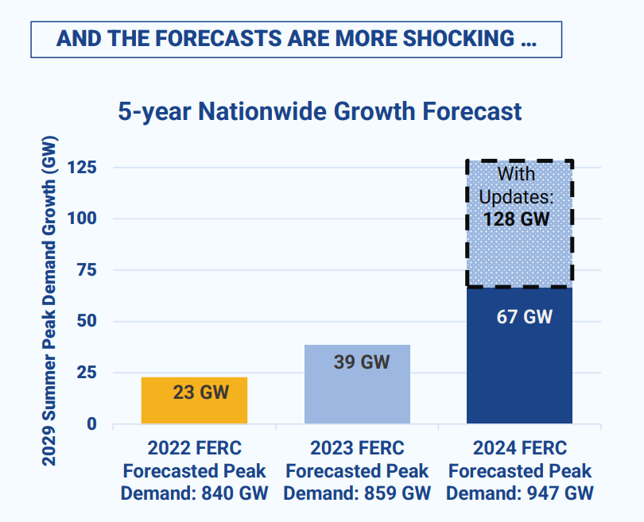
National Peak Demand Forecasted Growth has Tripled
“Power is the new labor.”
Source: Grid Strategies, EIA
Notes:
3/4/24
Following a robust 2023, most major US metros are forecast to see lower GDP and job growth in 2024. Some metros are on pace to see only tepid GDP growth in 2024 and, in a few cases, flat job growth, as the economy slows with a dwindling pool of excess savings, lower fiscal stimulus, and the weight of higher interest rates also curbing consumer spending.
All of the top 50 metros are forecast to see very modest GDP growth in 2024, and the range of growth rates within the metros will narrow considerably due to broad-based weakness across most sectors. Metros with a tech focus or large hospitality sector are forecast to lead growth. These include San Jose, Austin, Seattle, Orlando, and Las Vegas.

Slide 15
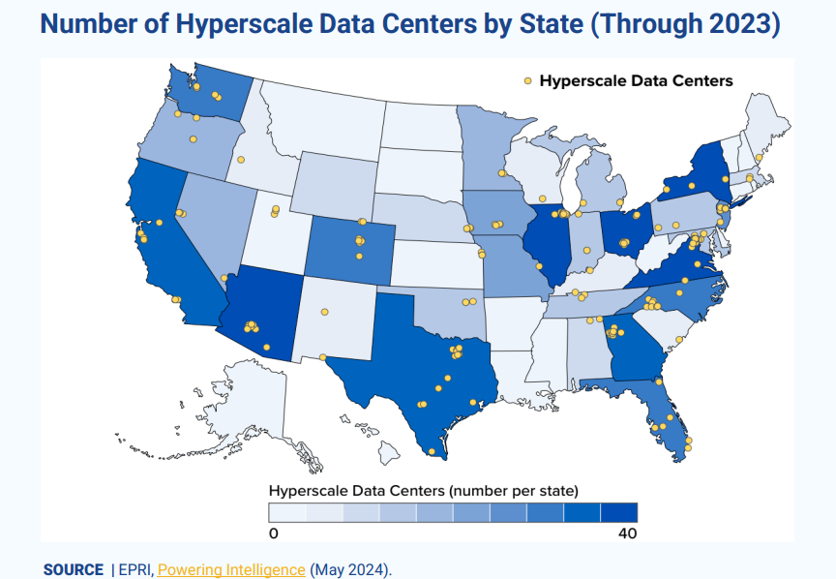
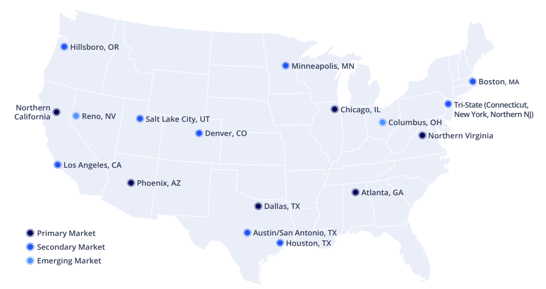
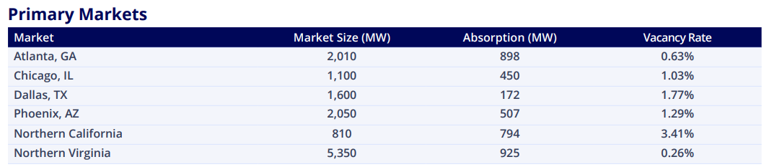
Data Center activity is concentrated in a few core markets but increasingly flowing to anywhere with power

Slide 16
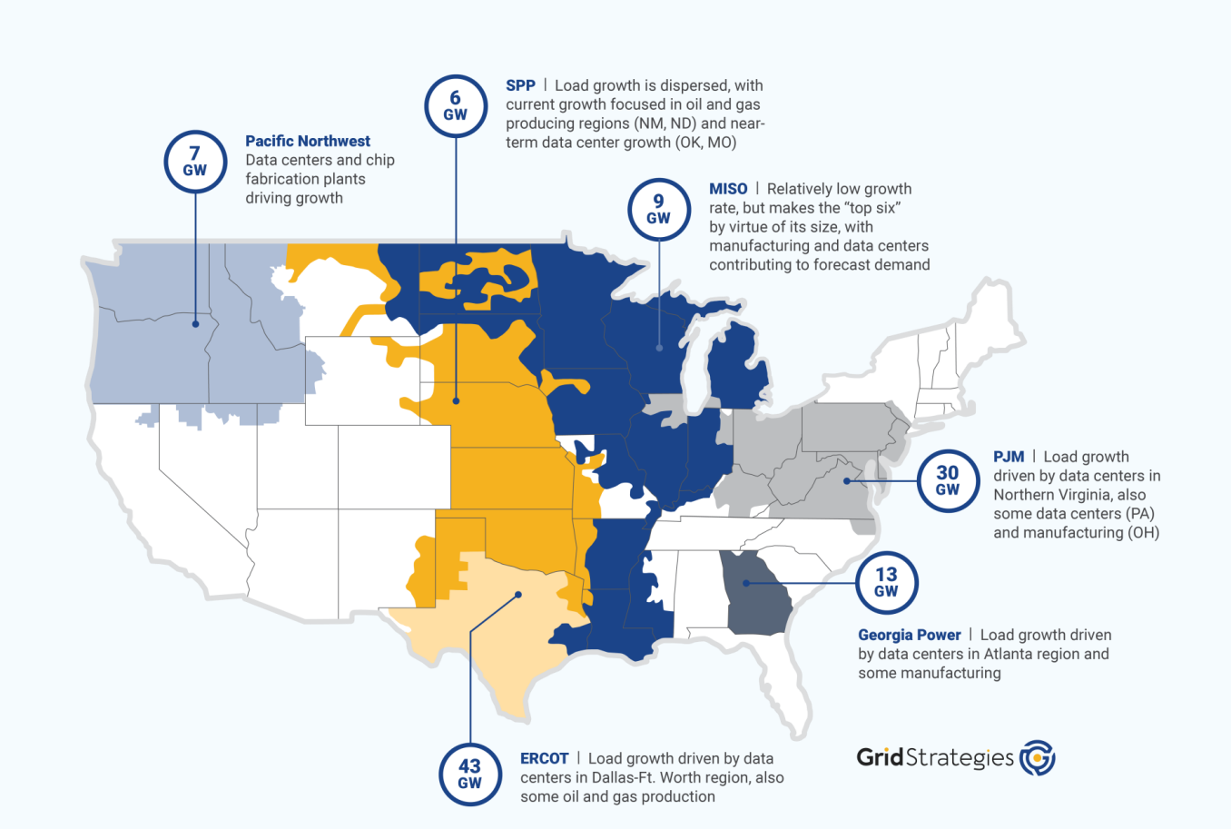
Dallas, Northern Virginia, Pennsylvania and Atlanta are Driving Growth in Demand
Source: U.S. Energy Information Administration

Slide 17
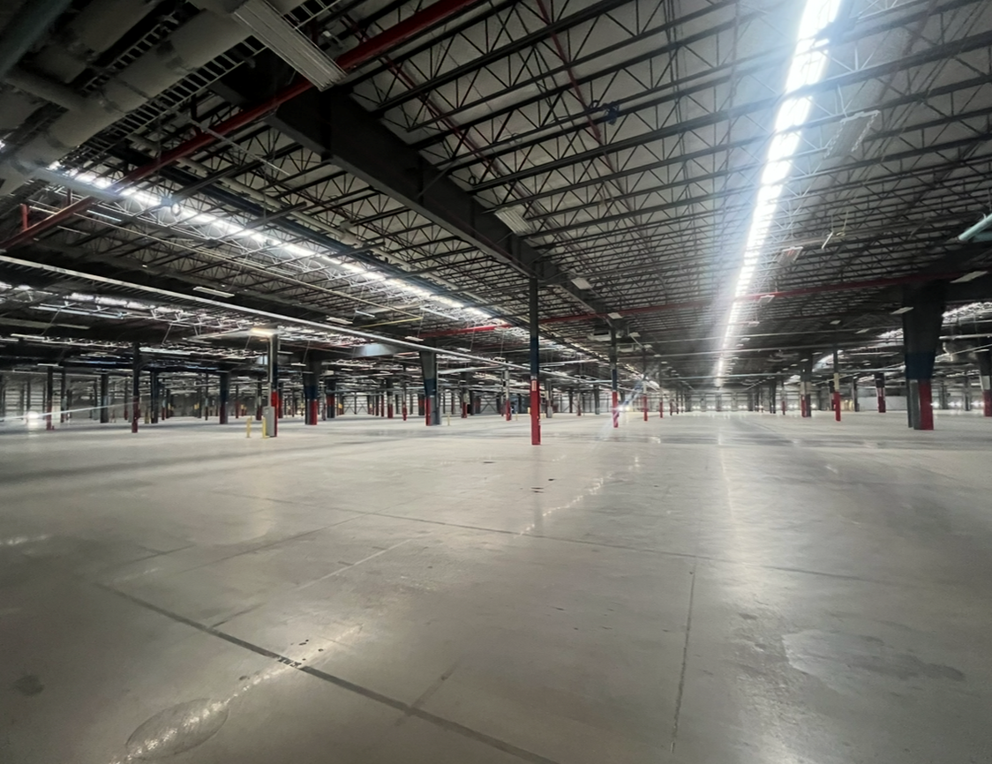


Industrial has new competition
How it started - $35M
How its going - $3B

Slide 18
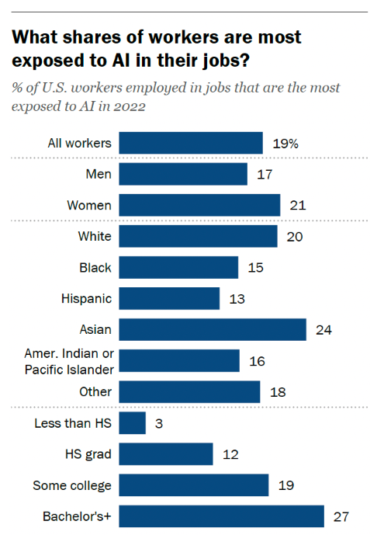
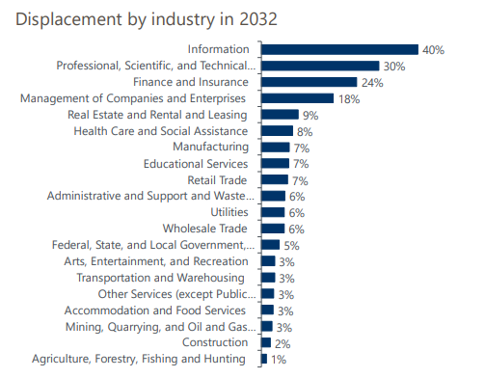
White collar workers are the most likely to be impacted by AI
SW:
AI’s greatest impact will be seen by white-collar, higher earning employees
  Source: Pew Research Center

Slide 19
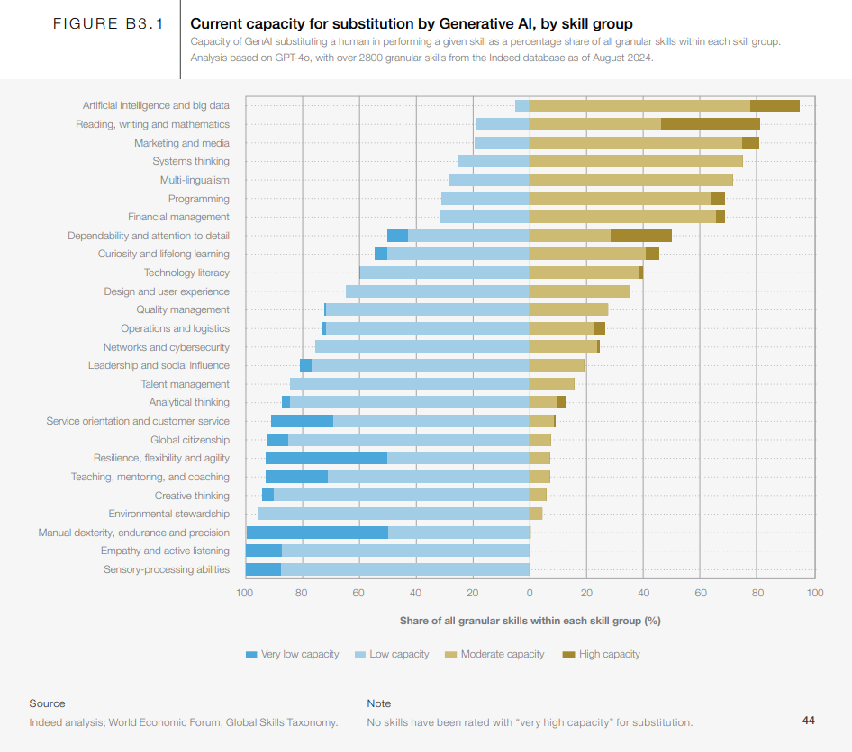
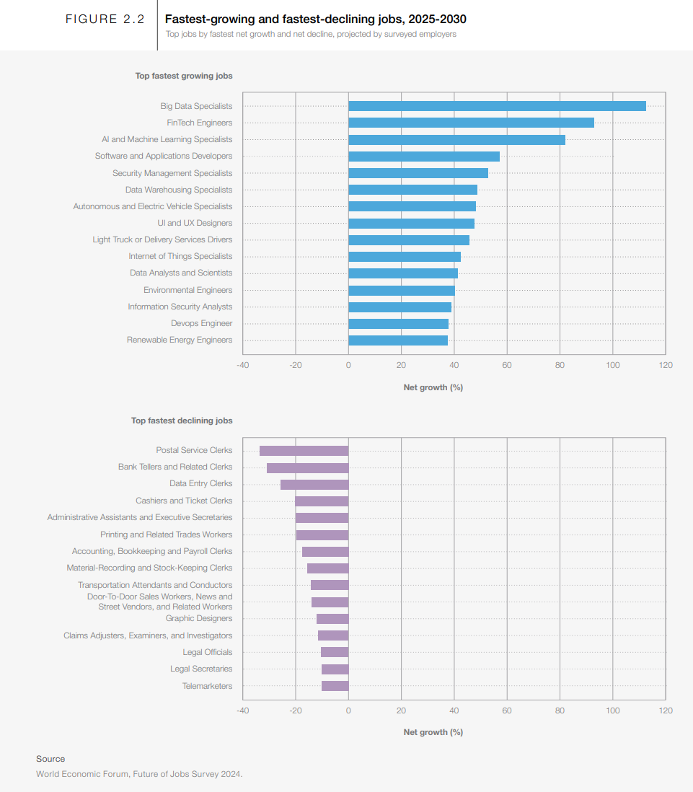
The paradoxical impact of AI on labor
SW:
AI’s greatest impact will be seen by white-collar, higher earning employees
  Source: World Eonomic Forum

Slide 20
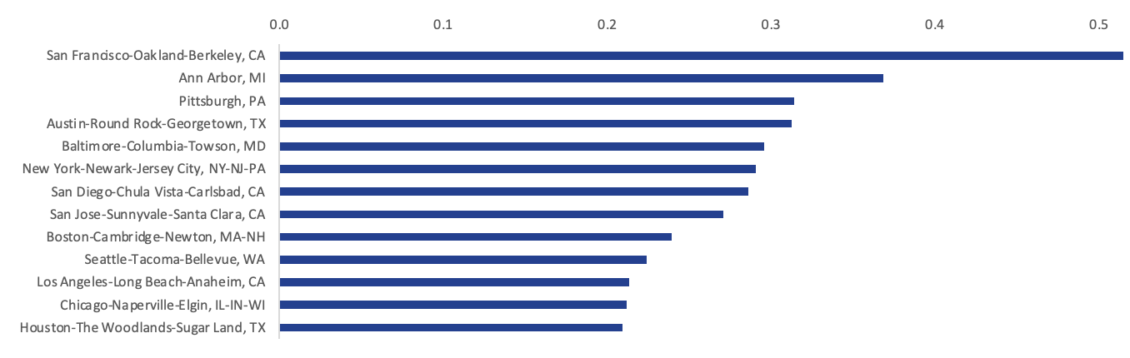
The Bay Area and Several Top University Towns (including Ann Arbor) are Hotbeds for AI Talent
San Francisco had more than 1 AI skilled work per 2 software developer jobs while the median of the top 50 cities for AI talent was just one skilled AI worker for every 7 software developer jobs
*Data for top 50 cities by profiles with Artificial Intelligence skills
**Cities were condensed into MSAs (ex. both Boston, MA & Cambridge, MA were combined into Boston-Cambridge-Newton, MA-NH)
Notes:
The Bay Area led the county in ratio of AI skilled workers to Software Developer jobs with San Francisco leading the country and San Jose home to the 8th best ratio

Slide 21
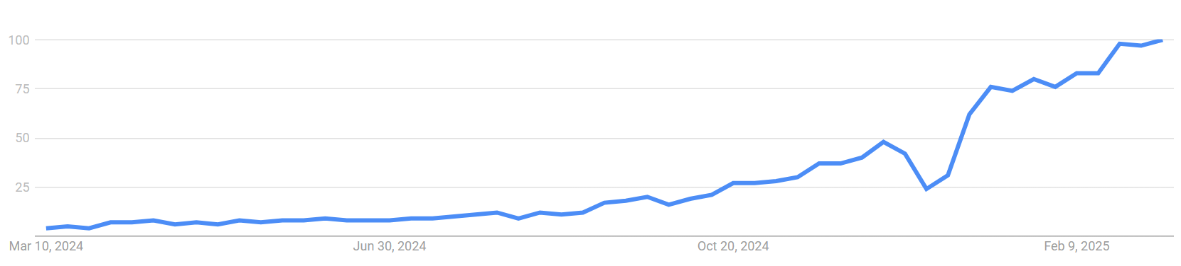
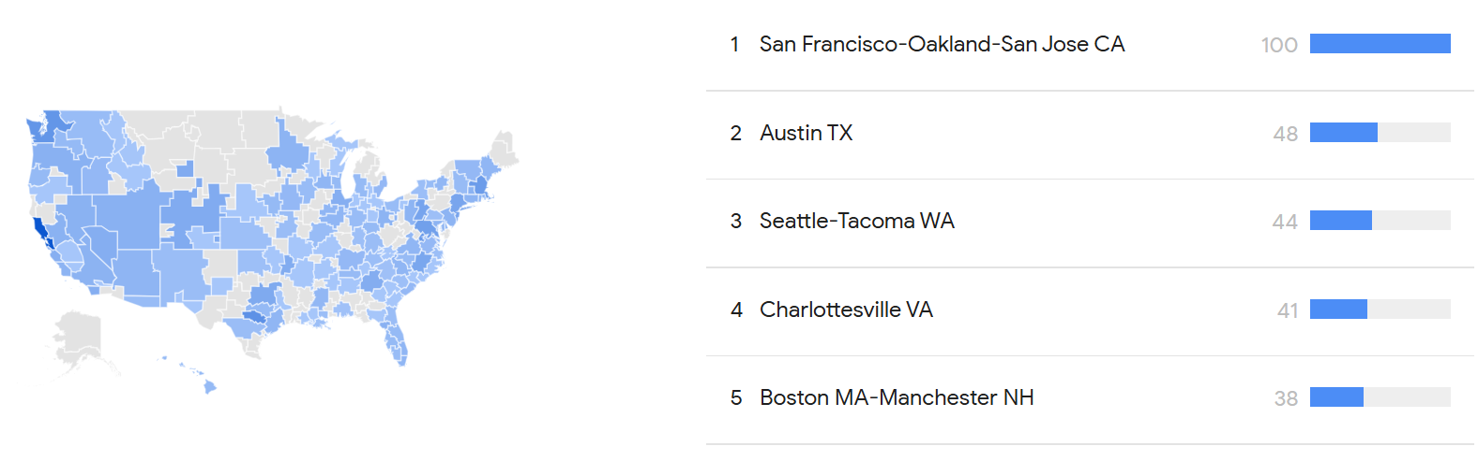
The “Agentic Age” is upon us
Last 12-Months Search Activity for “Agentic”

Slide 22
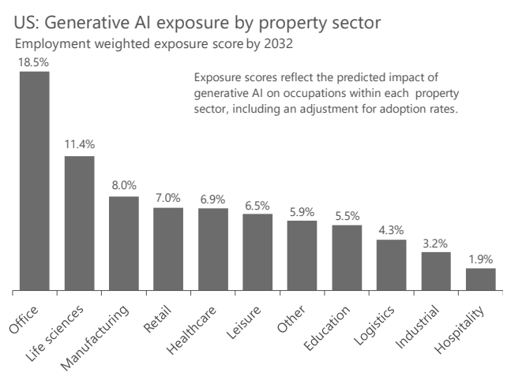
The office property sector is poised for the highest level of AI exposure
Source: Oxford Economics

Slide 23
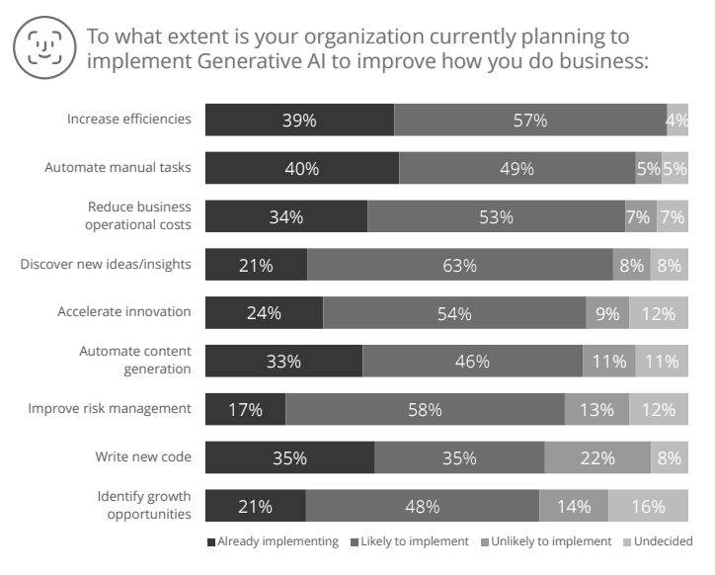
Part of the reason for AI’s rapid adoption is it is a valuable tool to enable the shift to cost efficiency rather than growth
Cost Emphasis
Source: Deloitte, Colliers Location Intelligence

Slide 24
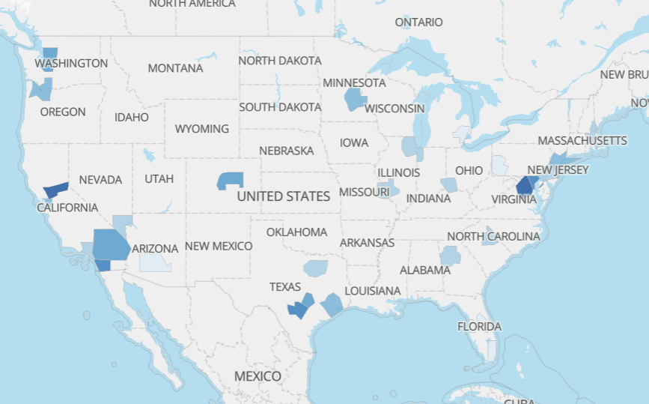
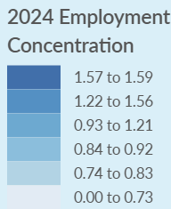
Government employment density is highest in some of the most expensive cities in the U.S.
(100 = U.S. Average)
(1.0 = U.S. Average)
Source: U.S. Census Bureau, Lightcast

Slide 25
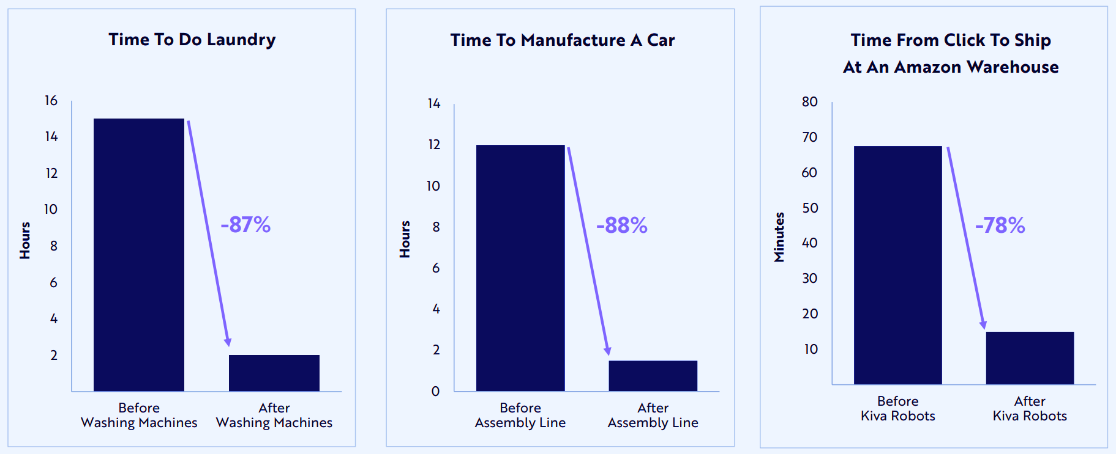
Robotics have a history of boosting productivity and transforming industries
Source: Ark Invest

Slide 26
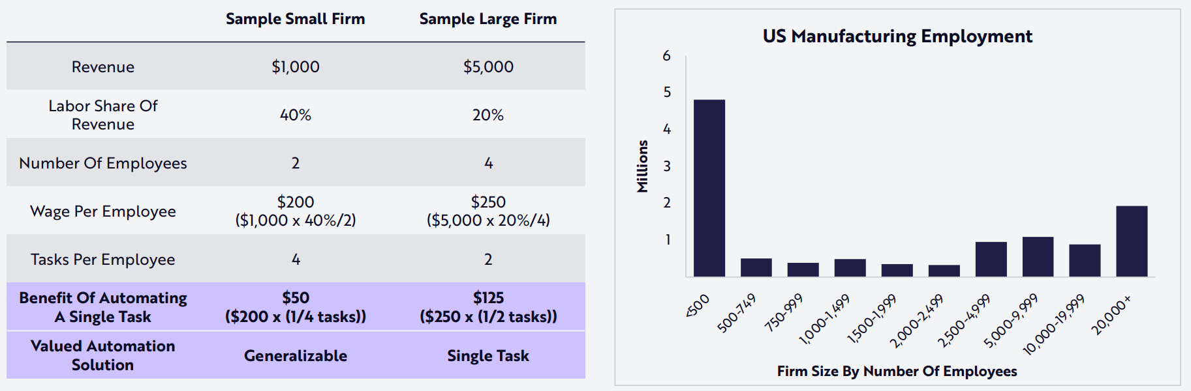
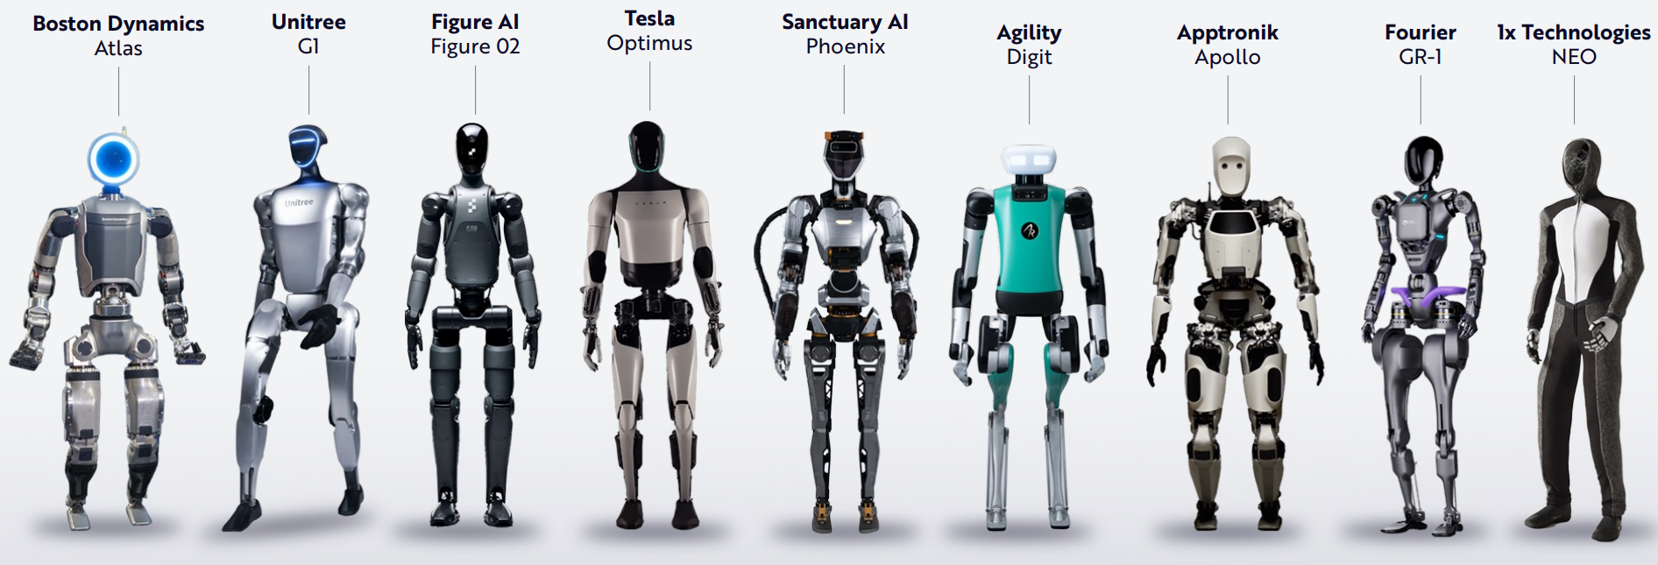
The robotics boom should be disproportionately beneficial for smaller manufacturers
Source: Ark Invest

Slide 27
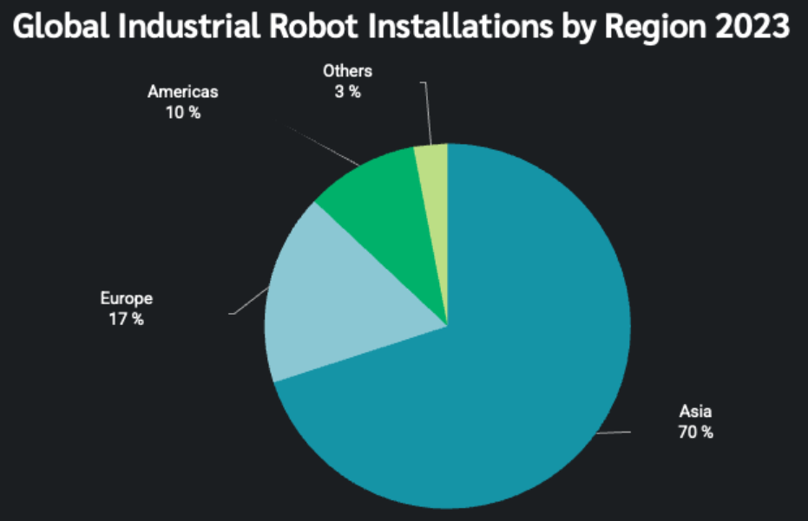
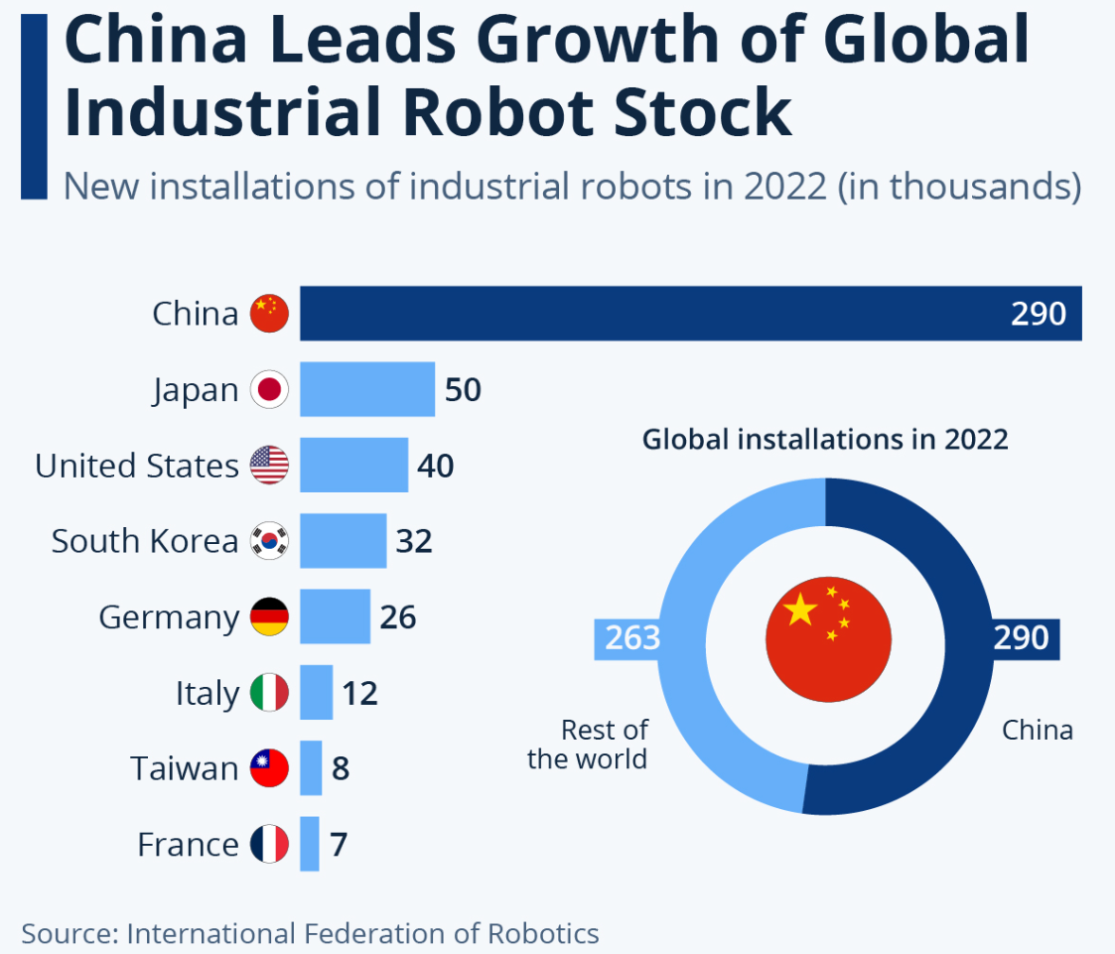
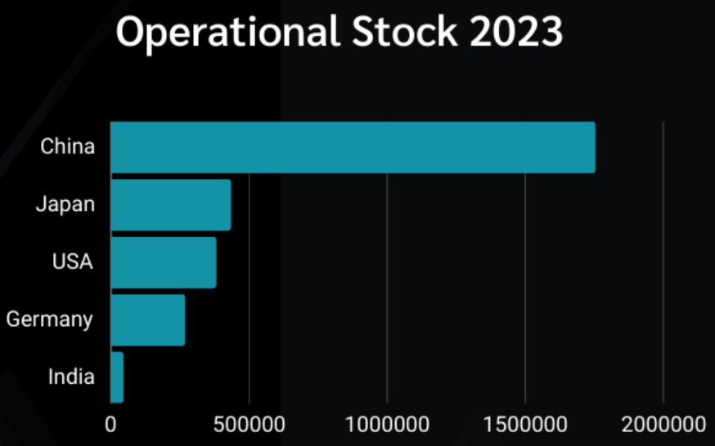
The Boom in Robotics is dominated by China

Slide 28


Shifting Demographics
"Demographics are the most important factor that will drive the global economy over the next 30 years."
- Ray Dalio, Founder of Bridgewater

Slide 29
Flattening Population Growth Presents Challenges
Global Population Reached 8 Billion in 2022 but slower Growth Lies Ahead
Peak Global Population
+30%
+167%
2022

Slide 30
U.S. fertility rate hits record low after trending down for years
U.S. Fertility Rate
Replacement Rate (2.1)
Source: CDC

Slide 31
The labor market has softened from the 2022 peak but is still strong due to high demand and limited supply
Labor Market Strength Index

Slide 32
There is still more than 1 job opening per unemployed individual
Quits Rate
Jobs Openings/Unemployed Persons
Sources: FRED, S&P

Slide 33
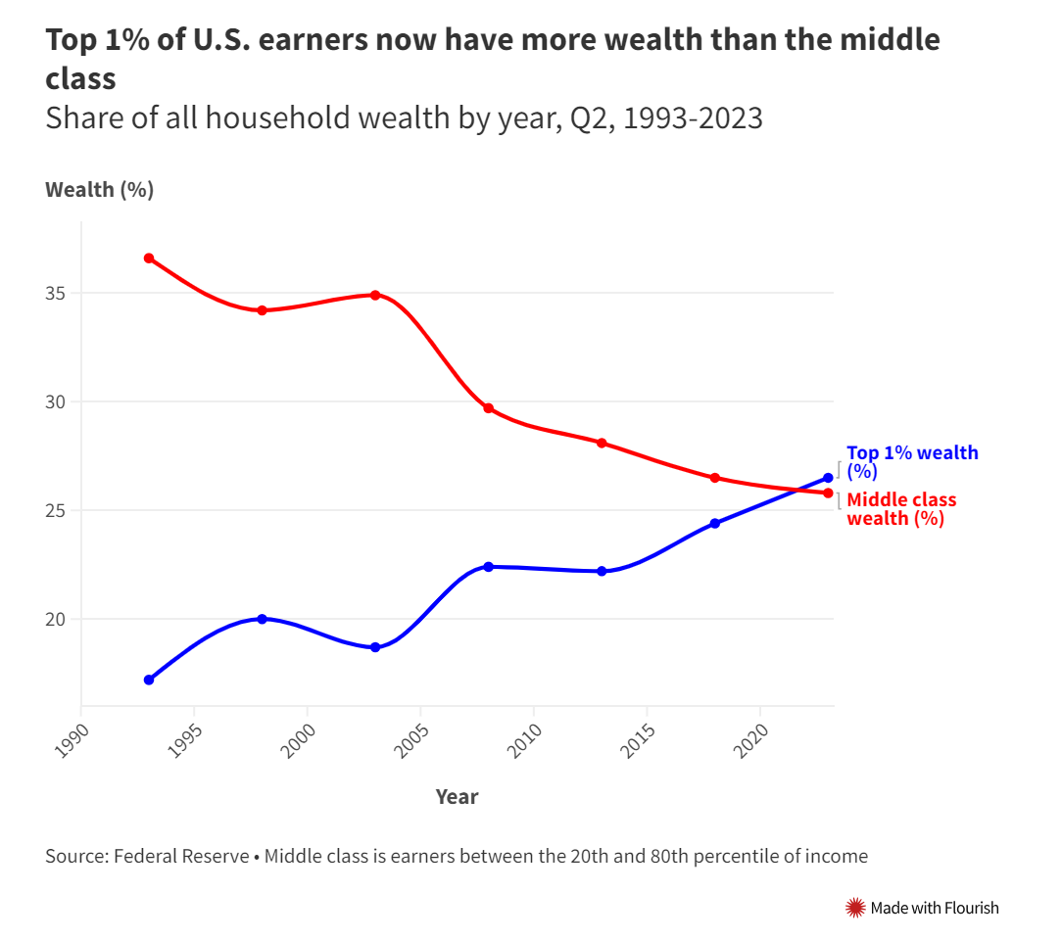
Despite a strong labor market, the wealth gap is widening
"Wealth inequality, if it continues to rise, will have significant implications for economic and social stability.“
– Ray Dalio

Slide 34
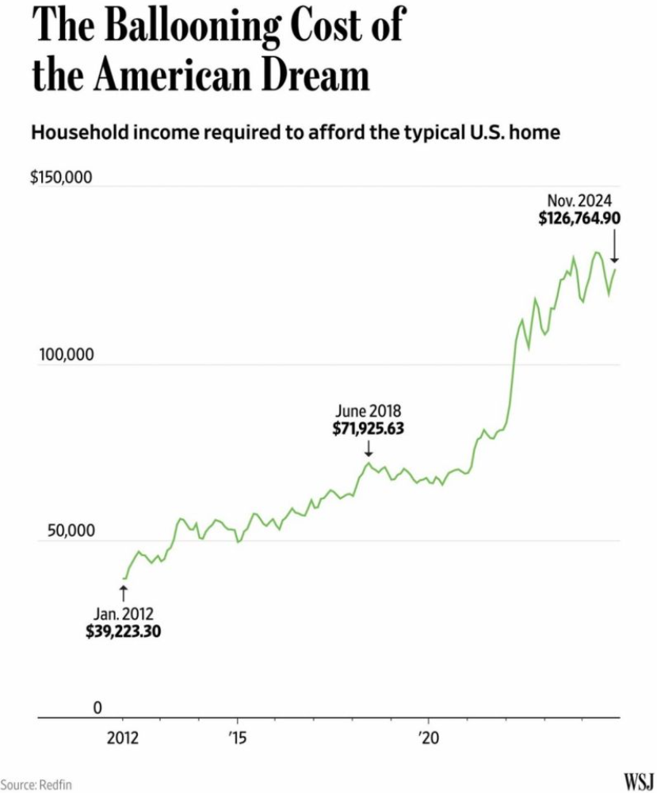
The income required to afford a typical house in the U.S. has more than tripled in the last 12 years
Share of U.S. home listings affordable on median income
Source: FRED, Redfin

Slide 35
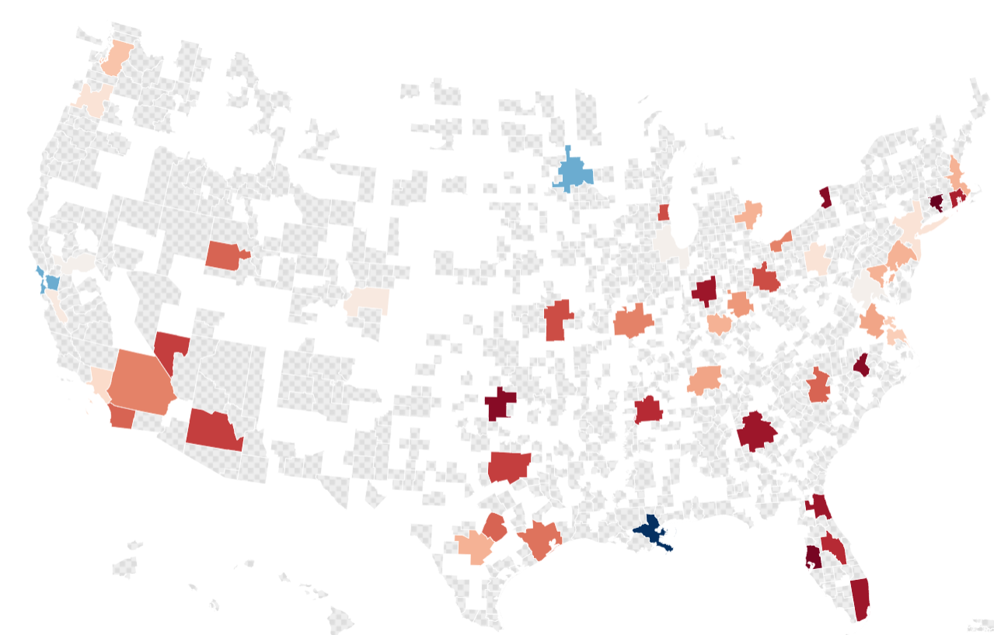
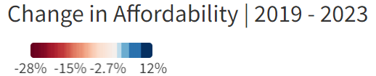
The Southeast has seen the most rapid decline in affordability
4
Zillow’s top rated MSAs for Home Appreciation in 2022
2
3
1

Slide 36
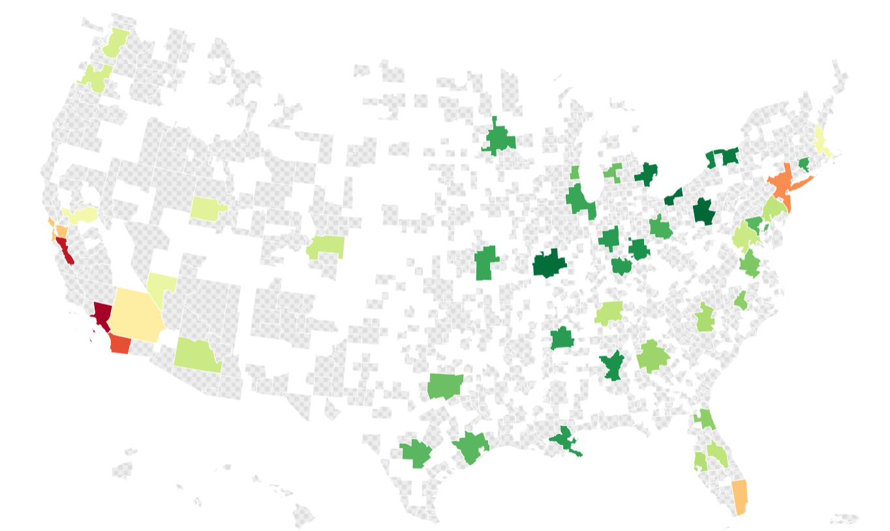
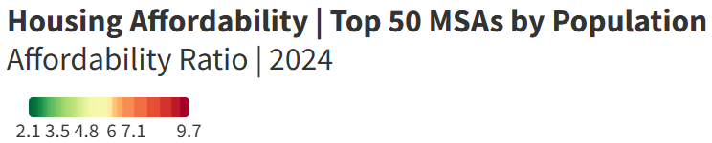
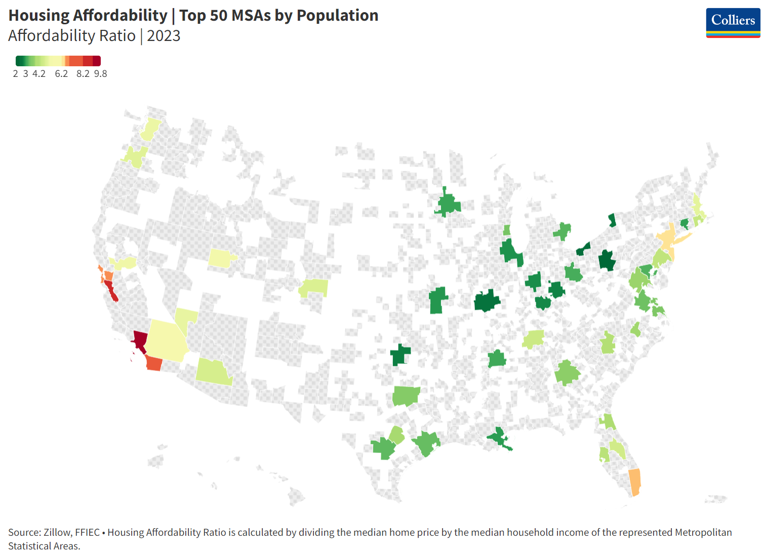
The Midwest, Texas and the Rustbelt are the most affordable Regions
Zillow’s top rated MSAs for Home Appreciation in 2024
Zillow’s top rated MSAs for Home Appreciation in 2025
2
1
1
3
4
2
4
3

Slide 37


Deglobalization
"Deglobalization is one of the most important
trends facing investors today.“
- Larry Fink, CEO of BlackRock

Slide 38
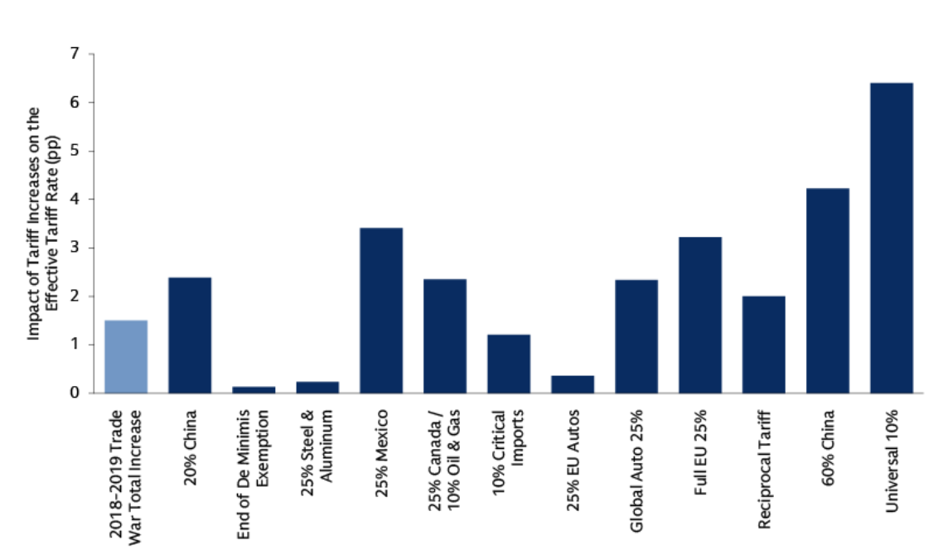
Tariff rates have increased inflation expectations and decreased growth expectations
“We have raised our tariff expectations. We had been expecting a 4-5% increase in the effective tariff rate, now we are expecting a 10% increase in the effective tariff rate.“
– David Mericle
Chief US Economist, Goldman Sachs
Source: U.S. Energy Information Administration

Slide 39
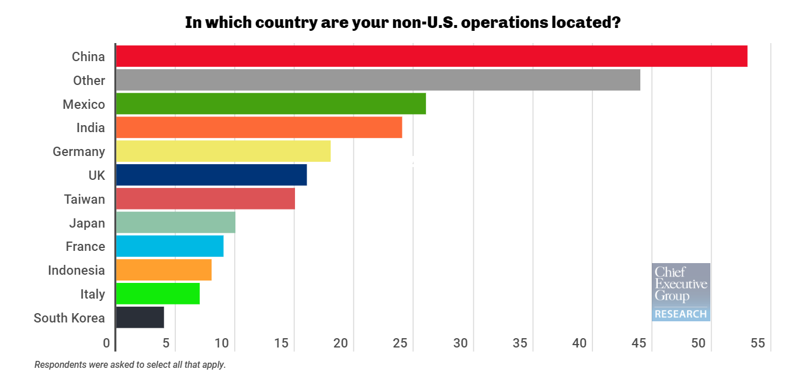
Although China is the top location for non-U.S. operations, there has been a significant decrease in trade volumes over the last 5 years
5-year Change in Trade Volume Mix
-22%
4%
44%
-5%
-4%
39%
-16%
-5%
6%
13%
Source: BLS & Colliers Research

Slide 40
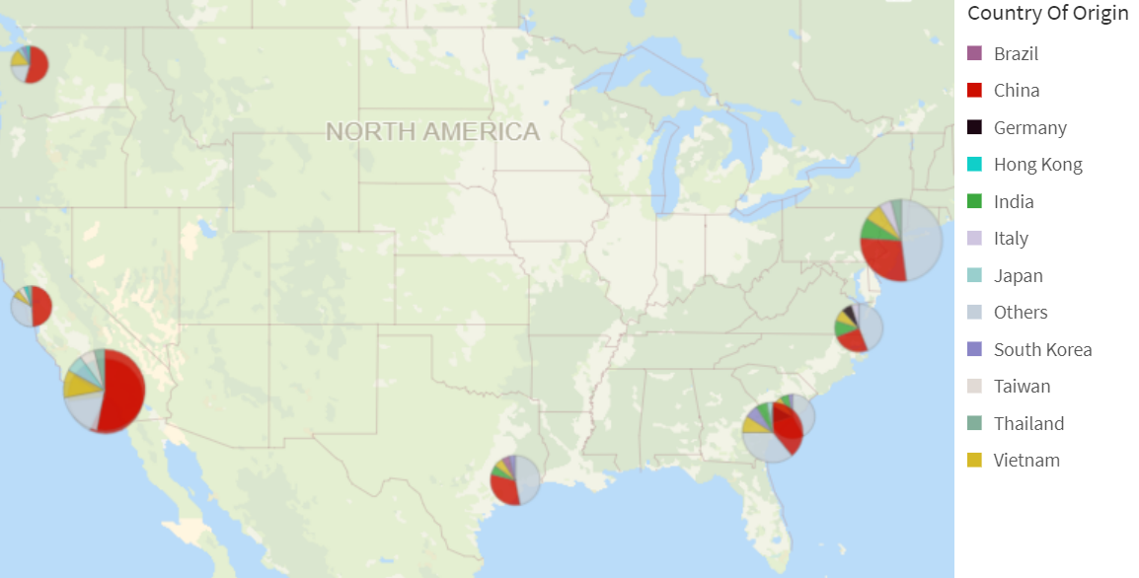
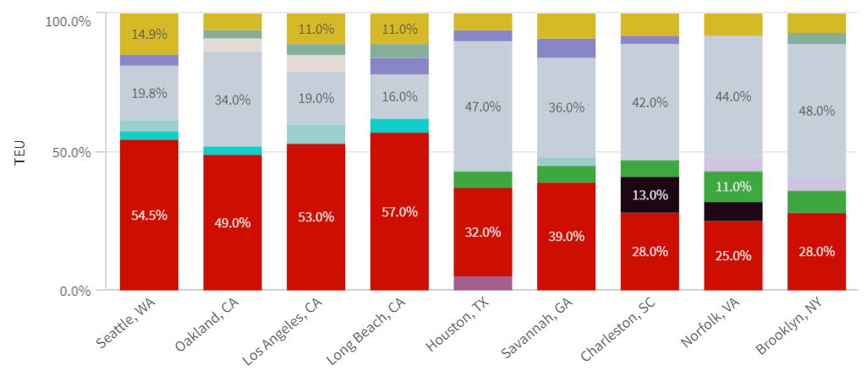
West Coast ports dependence on China has contributed to softness in those markets
TUE Mix by Origin Country
TUE Mix by Port by Origin Country
West Coast
Gulf & East Coast
Data is sourced from ReshoreNow, Colliers Workforce Intelligence Platform (WIP) and emsi

Slide 41
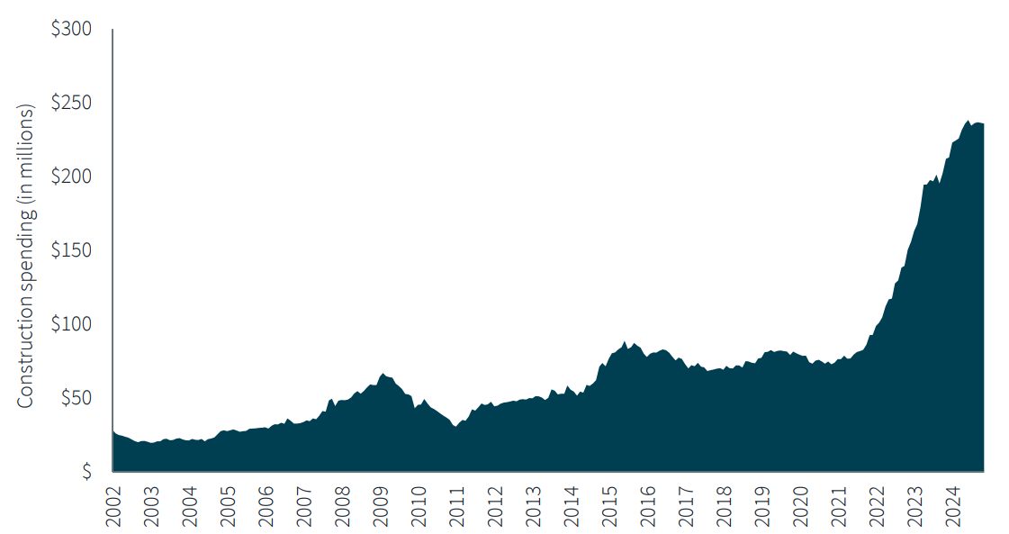
Manufacturing Related Construction Spending is up 200%+
Source: U.S. Census Bureau

Slide 42
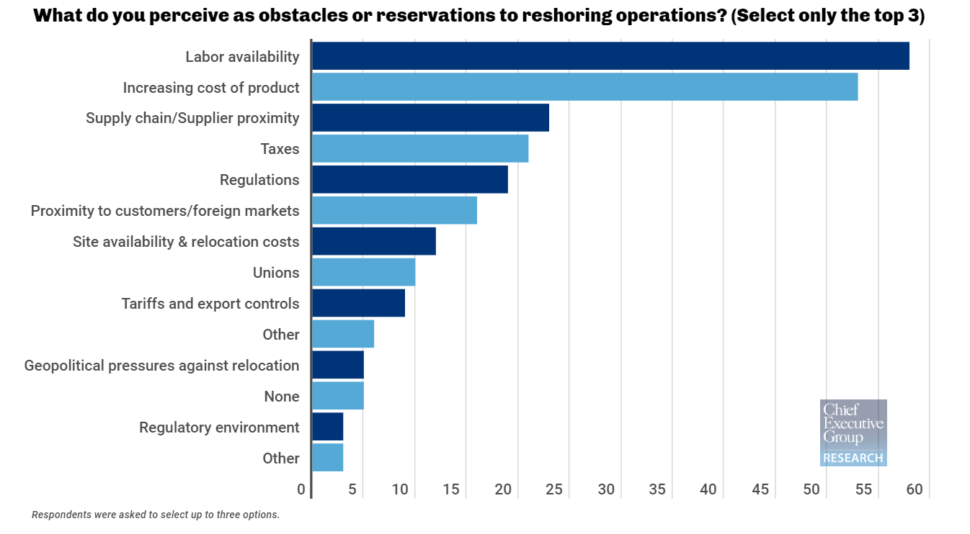
CEO’s top obstacles to reshoring operations?

Slide 43
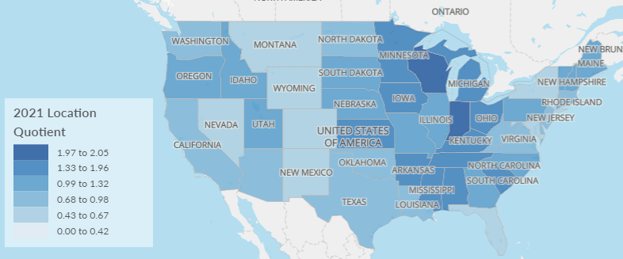
7 of the top 10 Destinations for Onshoring Jobs in 2023 located in established manufacturing markets
7
9
8
2
10
1
6
3
4
5
Data is sourced from ReshoreNow, Colliers Workforce Intelligence Platform (WIP) and emsi

Slide 44
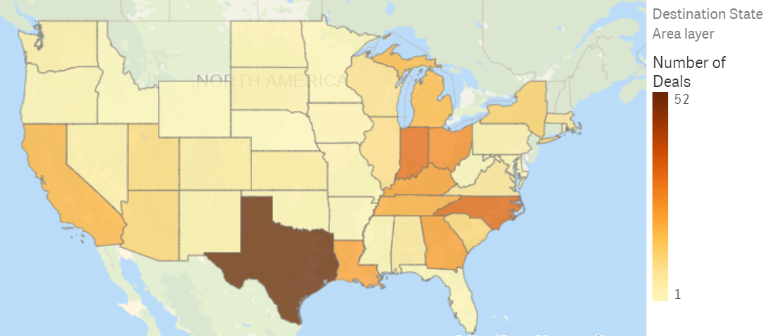
Large Capital Projects ($250M+) post-COVID have Focused on the Midwest, Southeast and Texas
Mega Project Activity Has Accelerated
Data is sourced from Colliers Workforce Intelligence Platform (WIP), FDI Intelligence

Slide 45
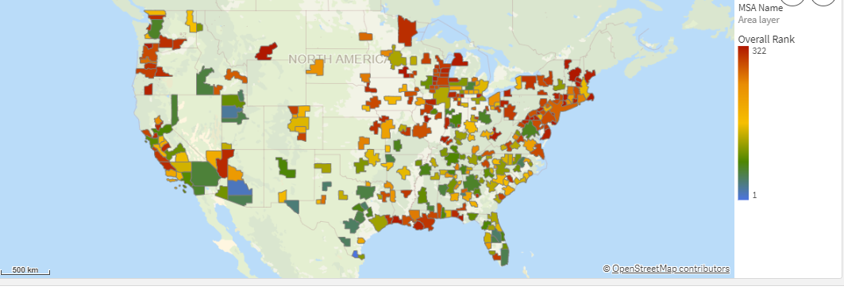
Analytics are Driving Location Decisions
Top Markets for Green Manufacturing Talent
The top markets are concentrated in the Lowed Midwest, Southeast, Texas and Mountain West
Source: Colliers WIP

Slide 46
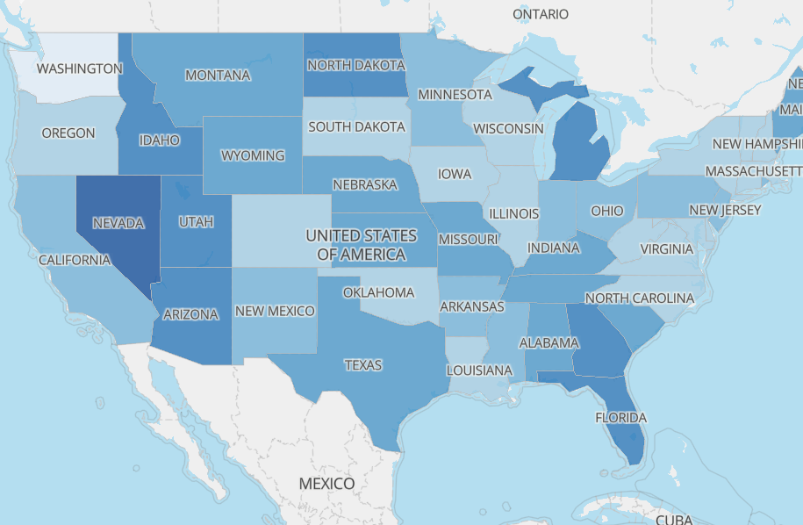
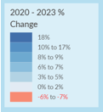
Swing States Have Benefitted from Onshoring
Notes:
Political Implications for presentation:
Population growth favors Biden in states he narrowly won like Arizona, Georgia, and Wisconsin.
Many new residents come from Democratic-leaning areas like Chicago, LA, and Minneapolis.
However, immigration remains a vulnerability for Biden, with swing state voters trusting Trump more on the issue.

Slide 47
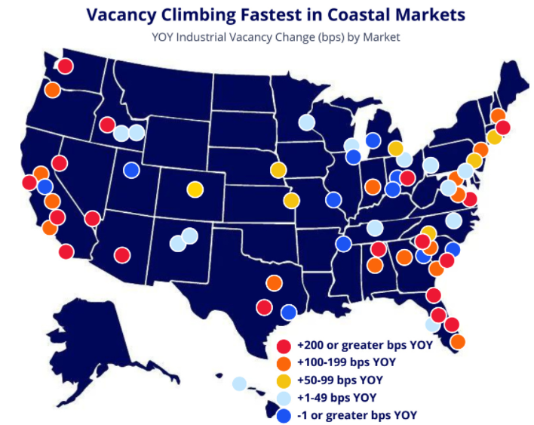

Industrial vacancy has elevated substantially, especially in costal markets

Slide 48






Monitoring Change in Demand Signals to Deliver a Sustainable Competitive Advantage and Transform Delta into Alpha
Macro Changes
Risk
Return
Speed
Confidence
α
Analytical Expertise
Real Estate Expertise
Notes:
Minimizing risk and maximizing returns by enabling you to move faster and with more confidence in an environment of accelerating change

