Slide 1
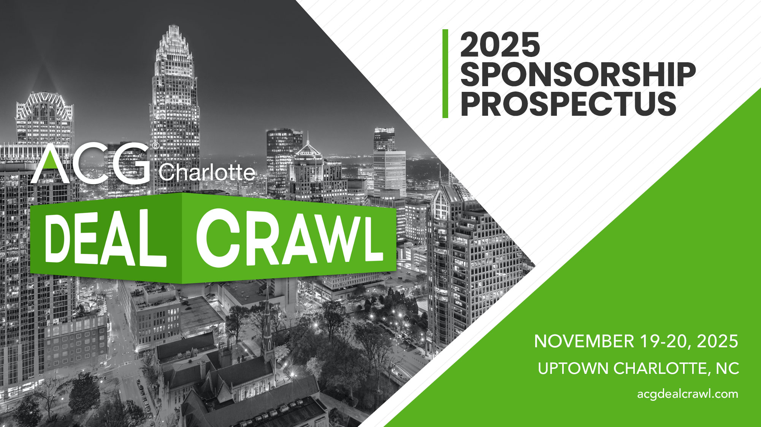

Slide 2
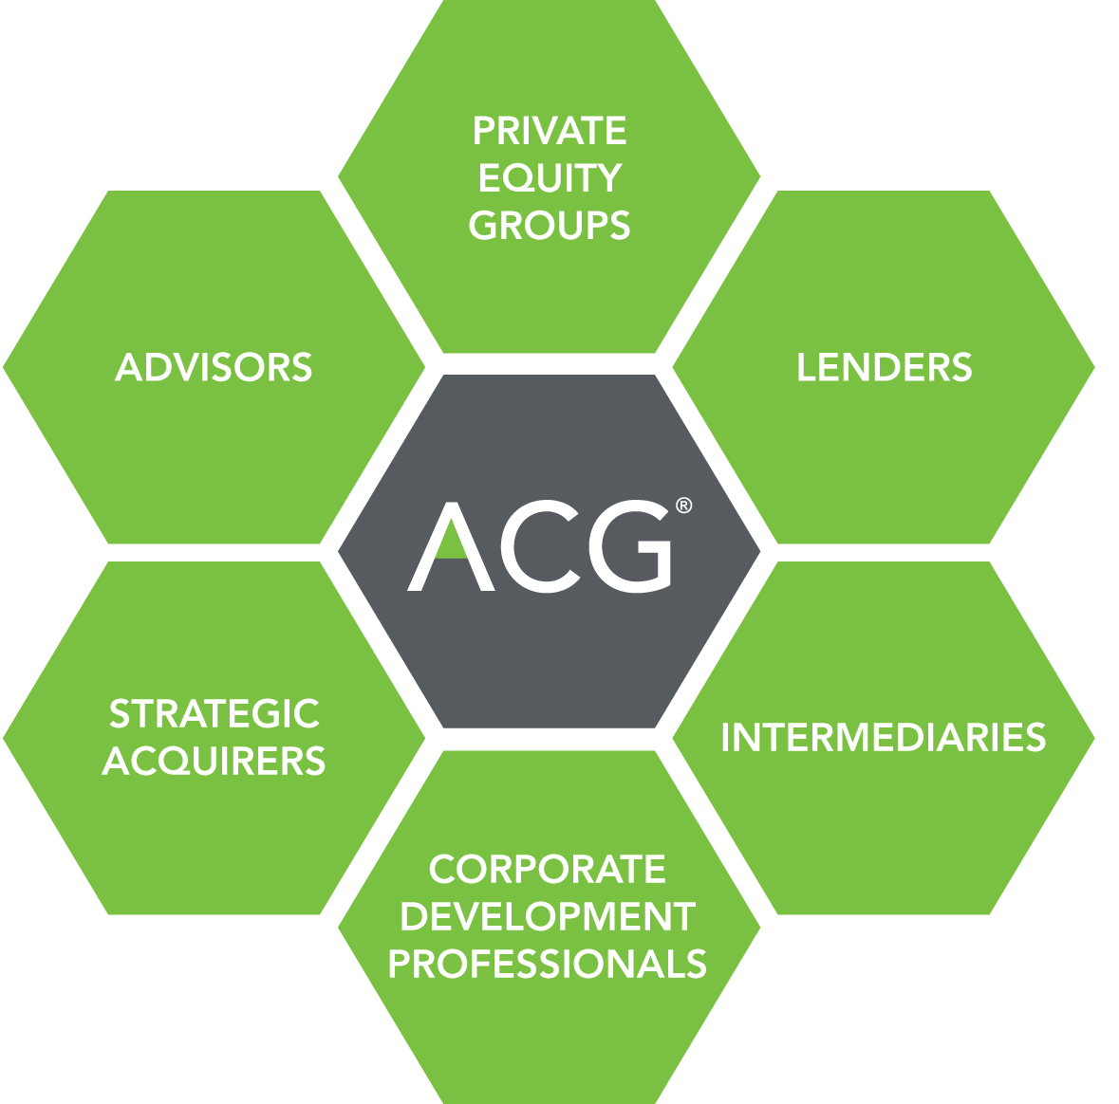
ACG Global & ACG Charlotte: Driving Middle-Market Growth
Founded in 1954, ACG is the premier M&A deal-making community with a mission of driving middle-market growth. ACG’s global network operates within 61 local markets worldwide and comprises more than 100,000 middle market professionals who invest in, own and advise growing companies.
ACG brings together every segment of the middle-market growth community and delivers the right people, in the right way, to our members.
The return on investment has made ACG the most trusted and respected resource for middle-market dealmakers and business leaders.
ACG Charlotte, founded in 1990, is dedicated to delivering quality programming and increasing networking opportunities for professionals in Charlotte and the surrounding areas.
The acg community includes
Visit www.acg.ORG/Charlotte
to learn more

Slide 3
Deal Crawl 2025
Deal Crawl is a unique networking event bringing together leading investment bankers, private equity professionals and trusted advisors from across the U.S.
On Wednesday, November 19, the conference kicks off with our Opening Networking Reception at Bank of America Stadium.
On Thursday, November 20, attendees will participate in a full day of 1-on-1 meetings and conference activities. For the convenience of attendees, all meetings and activities on Thursday will be at the JW Marriott. Dealmakers’ Lounge will be open throughout the day offering attendees the opportunity to engage with our sponsors at their exhibit tables, have meetings and network. We’ll host a Networking Breakfast, Affinity Seminar and Keynote Lunch. As meetings wrap up, attendees will be invited to a Closing Happy Hour to conclude networking.
All attendees will have access to our scheduling platform in advance of the conference to preschedule meetings with other attendees.
12TH annual
deal crawl conference
November 19-20, 2025
Uptown Charlotte, NC

Slide 4
Conference
agenda

Slide 5
Deal Crawl 2025 - Schedule of Events
Wednesday, November 19
Thursday, November 20
5:30PM – 8:00PM | Opening Networking Reception at Bank of America Stadium
7:30AM – 9:00AM | Networking Breakfast
8:00AM – 12:00PM | 1-on-1 Meetings
9:00AM – 10:00AM | Affinity Seminar*
12:00PM – 1:30PM | Keynote Lunch
1:30PM – 5:00PM | 1-on-1 Meetings
4:30PM – 5:30PM | Closing Happy Hour
All meetings and events listed above, except the opening reception, will be held at the JW Marriott Charlotte.
Dealmakers’ Lounge will be open throughout the day on November 20 featuring an exhibit hall and space for
meetings and networking at the JW Marriott.
*Affinity Seminar is a panel discussion covering relevant industry topics
All attendees will have access to the scheduling platform ahead of the conference to preschedule 1-on-1 meetings.
Specific times and event descriptions may change.

Slide 6
Conference Event Highlights
Opening networking reception
Join ACG Charlotte for an evening of networking at Bank of America Stadium, home of the Carolina Panthers and the Charlotte Football Club. Connect with industry professionals over delicious hors d’oeuvres and drinks.
Dealmakers’ loungE
Visit a sponsor exhibit table, hold meetings, catch up on emails or mingle with other conference attendees in between meetings and sessions. Coffee and snacks will be provided.
Networking breakfast
Enjoy breakfast and coffee as meetings and networking begin.
1-on-1 meetings
Attendees will have access to our scheduling platform to preschedule meetings. For the convenience of attendees, all meetings will take place at the JW Marriott.
Affinity seminar
Attend our Affinity Seminar, where panelists will lead a discussion covering important topics impacting the middle-market.
keynote LuncH
Join all attendees for lunch and an engaging presentation from our keynote speaker.
CLOSING HAPPY HOUR
Gather for a final networking opportunity and toast to a successful Deal Crawl.
Specific times and event descriptions may change.

Slide 7
Sponsorship
opportunities

Slide 8
Sponsorship Opportunities At-A-Glance | Platinum | Gold | Silver | Bronze | Growth | Affinity
Exclusive sponsor of opening reception | ●
Stage time at opening reception | ●
Reserved area at opening reception | ● | ● | ●
Exclusive sponsor of keynote lunch |  | ●
Stage time at keynote lunch | ● | ●
Acknowledgement at keynote lunch | ● | ● | ● | ●
Branded, reserved table at keynote lunch | ● | ●
Seat(s) at head table at keynote lunch | 2 | 1
Exhibit table in dealmakers’ lounge | ● (prominent location) | ● (prominent location) | ● | ● | ● | ●
Exclusive sponsor of one of the following: Coffee Bar, Lanyards, Closing Happy Hour or Dealmakers’ Lounge |  |  | ●
Exclusive sponsor of one of the following: Networking Breakfast, Wi-Fi, Pads & Pens, Featured Snacks, Beverage Stations, Conference Guide, ACG Access |  |  |  | ●
Exclusive sponsor of one of the following: Conference Map or Charging Station |  |  |  |  | ●
Sponsor of Affinity Seminar |  |  |  |  |  | ●
Branded conference welcome email to ACG Charlotte database | ●
Admission for attendees to conference | 10 | 7 | 5 | 3 | 1 | 1
Registration for sponsor’s investment banking, private equity, limited partner or lending arm (if applicable) | ● | ●
Opportunity to submit content and/or possible speaker for affinity seminar | ● | ● | ● | ● | ● | ●
Speaking opportunity during affinity seminar | ● |  |  |  |  | ●
Logo placement on event website, emails, signage & conference guide | ● | ● | ● | ● | ● | ●
Attendee list 2 weeks out & post-event | ● | ● | ● | ● | ● | ●
Right of first refusal for next year’s event | ● | ●
 | $15,000 Exclusive - Limit 1 | $12,000 Exclusive - Limit 1 | $7,500 Limit 4 | $4,500 Limit 8 | $3,000 Limit 2 | $3,000 Limit 2

Slide 9
PLATINUM SPONSORSHIP
*SOLD OUT*
Highest level of acknowledgement and exposure throughout the conference. Sponsor benefits include:
Exclusive sponsorship of conference opening reception held at
Bank of America Stadium on Wednesday, November 19
Opportunity to offer welcome remarks at opening reception
Reserved area in most prominent location at opening reception
Stage time at keynote lunch (Thursday, November 20)
Prominent acknowledgement at keynote lunch
1 branded, reserved table at keynote lunch
2 seats at head table at keynote lunch
Exhibit table in most prominent location in dealmakers’ lounge
1 branded conference welcome email to ACG Charlotte database of
6,000+ contacts (content to be approved by committee)
Admission for 10 attendees at conference ($3,800+ value)
Registration for sponsor’s investment banking, private equity,
limited partner or lending arm, if applicable ($570+ value)
Opportunity to submit content and/or potential speaker ideas for
affinity seminar (subject to approval by committee)
Sponsor representative guaranteed speaking opportunity during
affinity seminar (placement determined by committee)
Most prominent logo placement on event marketing including but not limited to event website, emails, conference guide, signage, etc.
Attendee list provided 2 weeks pre-event & final attendee list provided post-event
Right of first refusal to be next year’s Deal Crawl Platinum Sponsor
Exclusive Opportunity
*SOLD OUT*
$15,000

Slide 10
GOLD SPONSORSHIP
2nd Highest level of acknowledgement and exposure throughout the conference. Sponsor benefits include:
Exclusive sponsorship of keynote lunch held at the
JW Marriott on Thursday, November 20
Stage time at keynote lunch
Sponsor acknowledgment at keynote lunch
1 branded, reserved table at keynote lunch
1 seat at head table at keynote lunch
Reserved area at opening reception (Wednesday, November 19)
Exhibit table in a prominent location in dealmakers’ lounge
Admission for 7 attendees at conference ($2,660+ value)
Registration for sponsor’s investment banking, private equity,
limited partner or lending arm, if applicable ($570+ value)
Opportunity to submit content and potential speaker ideas for
affinity seminar (subject to approval by committee)
Sponsor representative may have speaking opportunity during
affinity seminar (placement determined by committee)
Prominent logo placement on event marketing including but not limited to event website, emails, conference guide, signage, etc.
Attendee list provided 2 weeks pre-event & final attendee list provided post-event
Right of first refusal to be next year’s Deal Crawl Gold Sponsor
Exclusive Opportunity
Limited to 1 Sponsor
$12,000

Slide 11
SILVER SPONSORSHIPS (4)
Category Exclusivity available.* Sponsor benefits include:
Exclusive sponsorship of ONE of the following:
  Coffee Bar
  Nametag Lanyards
  Closing Happy Hour
  Dealmakers’ Lounge
Acknowledgment at keynote lunch (Thursday, November 20)
Reserved area at opening reception (Wednesday, November 19)
Exhibit table in dealmakers’ lounge
Admission for 5 attendees at conference ($1,900+ value)
Opportunity to submit content and potential speaker ideas for
affinity seminar (subject to evaluation by committee)
Sponsor representative may have speaking opportunity during
affinity seminar (placement to be determined by committee)
Logo placement on event marketing including but not limited to event website, emails, conference guide, signage, etc.
Attendee list provided 2 weeks pre-event & final attendee list post-event
* Exclusivity available in the following categories: private equity, investment banking, debt provider, commercial banking, private banking/wealth management, accounting, legal, insurance.
Limited to 4 Sponsors
$7,500

Slide 12
BRONZE SPONSORSHIPS (8)
Sponsor benefits include:
Exclusive Sponsorship of ONE of the following:
  Networking Breakfast
  Conference Wi-Fi
  Pads & Pens
  Featured Morning Snack
  Featured Afternoon Snack
  Beverage Stations
  Conference Guide
  ACG Access
Acknowledgment at keynote lunch
Exhibit table in dealmakers’ lounge
Admission for 3 attendees at conference ($1,140+ value)
Opportunity to submit content and potential speaker ideas for
affinity seminar (subject to evaluation by committee)
Sponsor representative may have speaking opportunity during
affinity seminar (placement to be determined by committee)
Logo placement on event marketing including but not limited to event website, emails, conference guide, signage, etc.
Attendee list provided 2 weeks pre-event & final attendee list post-event
Limited to 8 Sponsors
$4,500

Slide 13
GROWTH SPONSORSHIPS (2)
Sponsor benefits include:
Exclusive sponsorship of ONE of the following:
  Conference Map
  Charging Station
Exhibit table in dealmakers’ lounge
Admission for 1 attendee at conference ($380+ value)
Opportunity to submit content and potential speaker ideas for
affinity seminar (subject to evaluation by committee)
Sponsor representative may have speaking opportunity during
affinity seminar (placement to be determined by committee)
Logo placement on event marketing including but not limited to event website, emails, conference guide, signage, etc.
Attendee list provided 2 weeks pre-event & final attendee list post-event
Limited to 2 Sponsors
$3,000

Slide 14
AFFINITY SPONSORSHIPS (2)
Seminar leadership opportunity. Sponsor benefits include:
Joint-sponsorship of affinity seminar
As a seminar sponsor, you will:
  Be invited to submit content ideas and potential speakers (subject to evaluation by committee)
  Provide introductory or closing remarks at affinity seminar
  Provide seat drop of marketing materials or other branded items at affinity seminar
  Display branded signage at the affinity seminar
  (provided by ACG Charlotte)
Exhibit table in dealmakers’ lounge
Admission for 1 attendee at conference ($380+ value)
Logo placement on event marketing including but not limited to event website, emails, conference guide, signage, etc.
Attendee list provided 2 weeks pre-event & final attendee list post-event
Limited to 2 Sponsors
$3,000

Slide 15
Conference registration

Slide 16
REGISTER at www.acgdealcrawl.com
Registration Opens July 8
General Registration
General registration is designed for lenders, accountants, attorneys, consultants and other service provider participants. Registration includes access to the meeting scheduling software and all conference events including the Opening Reception, Dealmakers’ Lounge, Networking Breakfast, Affinity Seminar, Keynote Lunch and Closing Happy Hour for one individual.
Early Bird (July 8 – September 5)
ACG Members: $380
Non-Members: $460
Regular (September 6 – November 18)
ACG Members: $430
Non-Members: $510
If space is available, on-site registration will be $550 on November 19 & 20.
#DealCrawl

Slide 17
REGISTER at www.acgdealcrawl.com
Registration Opens July 8
Investment bank & Private Equity registration
For Investment Banks and Private Equity Firms. Includes access to the meeting scheduling software and all conference events including the Opening Reception, Dealmakers’ Lounge, Networking Breakfast, Affinity Seminar, Keynote Lunch and Closing Happy Hour for two individuals.
Investment Banks - $570
Private Equity Firms - $1,550
Additional attendees may be added to IB and PE registrations for $380/person.
#DealCrawl

Slide 18
Contact us

Slide 19
CONTACT US TO SECURE YOUR SPONSORSHIP TODAY!
BETSY BRYAN MANDL
Executive Director
ACG Charlotte
704-604-7959
bbmandl@acg.org
BRETT HUBLER
2025 Deal Crawl Chair
704-998-4082
brett.hubler@troutman.com
Visit www.acgdealcrawl.com for more details and to register
General Questions?
Contact us at: dealcrawl@acg.org

