Slide 1


2026
Sponsorship Opportunities
For more information, please contact:
Veronica Muñoz, Executive Director
vmunoz@acg.org
303-502-2113 x873
February 9-10, 2026
Hyatt Regency Downtown Denver
Jenae Anderson, Sponsorship Chair
JHAnderson@comerica.com

Slide 2
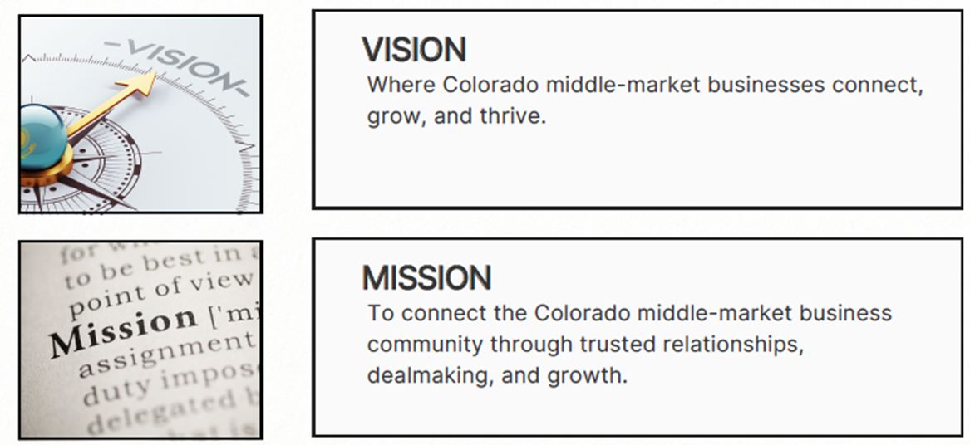
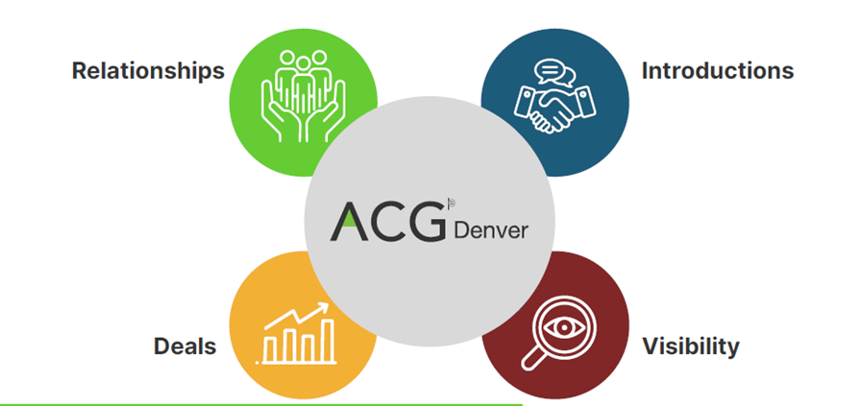
Gain exposure to key dealmakers and business leaders in the Denver community
Position your company as an industry leader
75% of ACG members do deals with other members
Brand recognition: Sponsorship offers countless opportunities to showcase your brand to ACG members

Slide 3

47% attendees are from out-of-state
Top represented states include Colorado, California, New York, Illinois, and Texas
Over 3,000 meetings held in Access meeting platform
Quick Facts:
Approximately 650-700 in attendance

Slide 4
Sponsorship Opportunity Snapshot
Capital Connection PE & IB Exclusive Reception - $17,500
Keynote Luncheon - $15,000
Corporate Development Officer Roundtable - $8,500
DealSource Lounge - $8,500
Access Meeting Scheduler - $7,500
Wi-Fi - $5,500
Main Capital Connection Reception - $5,000
Lanyards - $5,000
Coffee & Snack Bar - $5,000
Specialty Coffee Bar - $5,000
Powerful Connections Lunch - $5,000
Conversation Lounge - $5,000
Morning Session - $5,000
Afternoon Session - $5,000
Quick Knowledge Bites - $4,500
C-Level Host - $3,500
Closing Reception - $2,500
Pre-Ski Happy Hour - $2,500
Ski-Gaiters - $750
See below for details on each opportunity

Slide 5
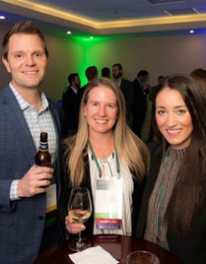
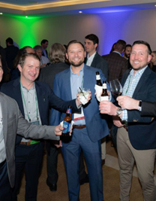

SOLD
Capital Connection Exclusive
Private Equity & Investment Bank Reception: $17,500
Number of sponsors: One Exclusive THANK YOU, CBIZ!
Benefits:
Logo prominence at Monday evening exclusive PE/IB Reception
Opening remarks
Logo prominence and company info on slide signage during Reception
One reserved table at Keynote Luncheon
Option for Signature Cocktail
Premier placement of Sponsor Exhibitor Table
8 complimentary Conference Registrations ($7,000 value)
Public acknowledgement of sponsorship at podium
Special Early Bird Member Pricing for additional guest registrations ($575 vs. $875 regular, non-member)
Ad and hyperlink on Conference website pages
Share company thought leadership in monthly newsletter (circ. 10K)

Slide 6
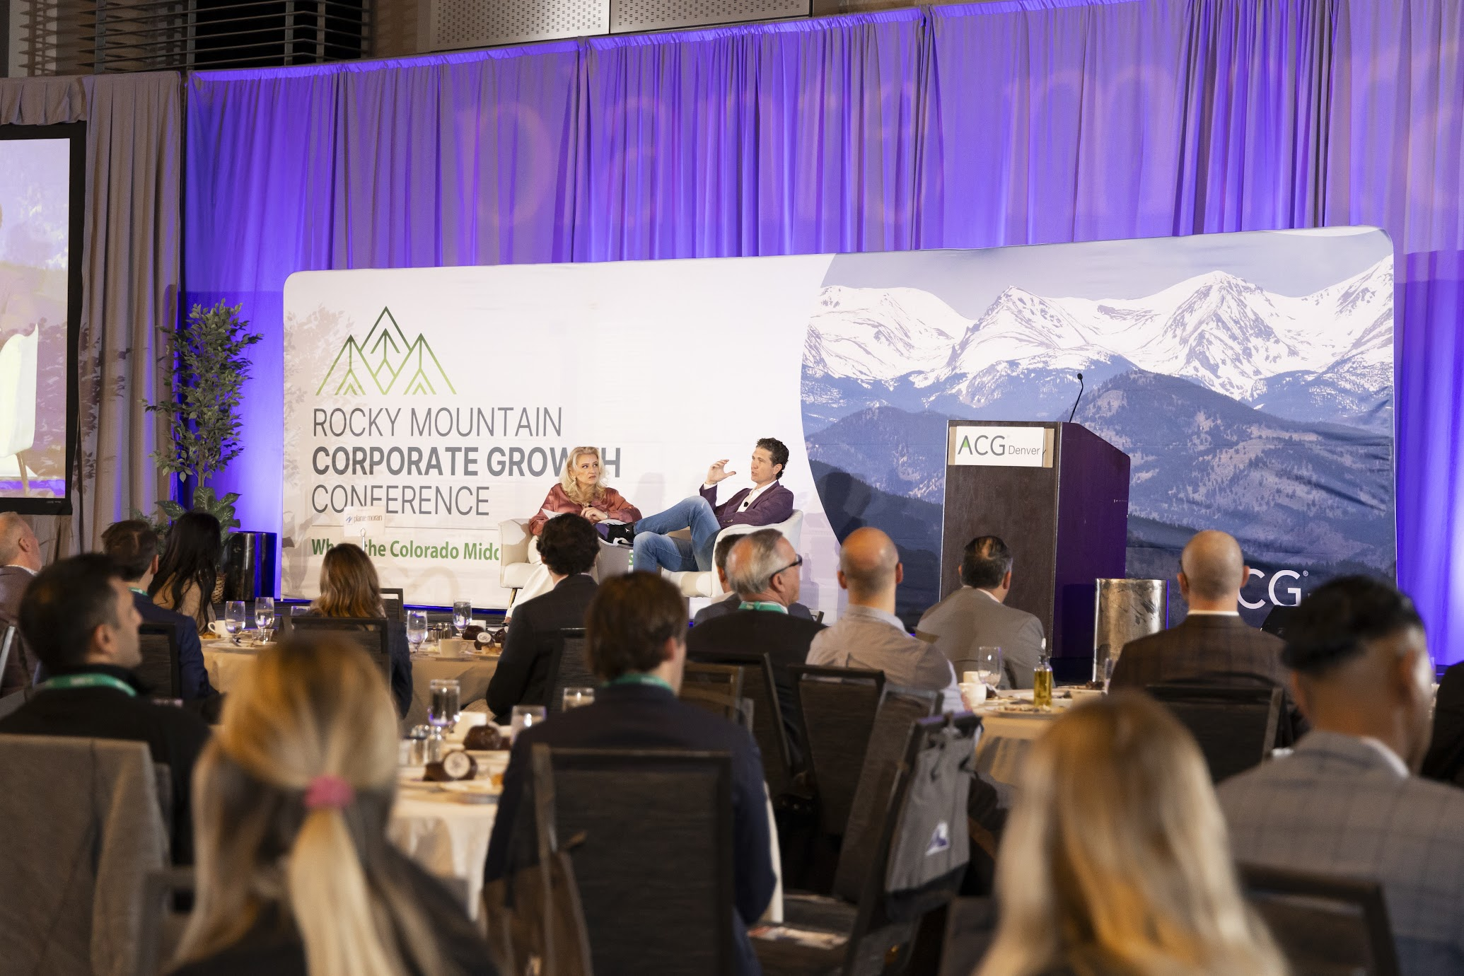
Keynote Luncheon: $15,000
Number of sponsors: One Exclusive THANK YOU, Plante Moran!
SOLD
Benefits:
Logo prominence at Monday Keynote Luncheon
Opportunity for Podium Visibility (introduce speaker or moderate)
Opportunity for input on Speaker(s) Selection (if commit prior to Sept. 1)
Prominent Gobo Company Logo projection
Two reserved tables at Keynote Luncheon (8-seat rounds)
Customized Dessert opportunity (depending on speaker/topic)
Premier placement of Sponsor Exhibitor Table
7 complimentary Conference Registrations ($6,125 value)
Public acknowledgement of sponsorship at podium
Special Early Bird Member Pricing for additional guest registrations ($575 vs. $875 regular, non-member)
Ad and hyperlink on Conference website pages
Share company thought leadership in monthly newsletter (circ. 10K)

Slide 7
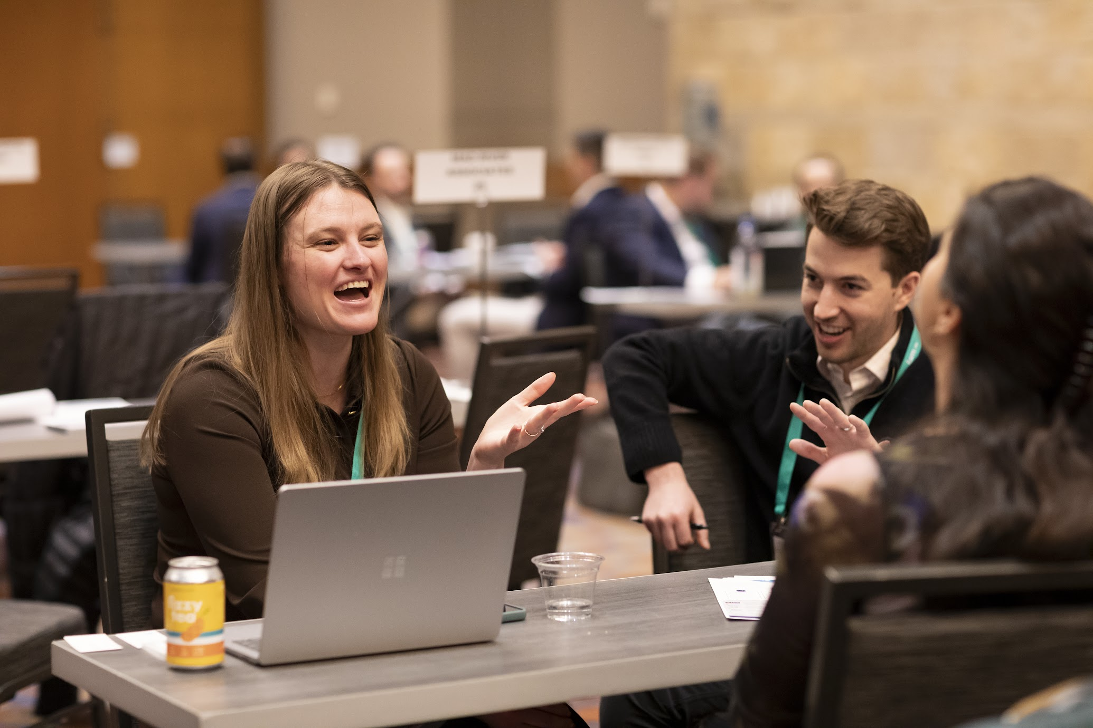
4 SOLD
DealSource Lounge: $8,500
Number of sponsors: Up to 5 sponsors
THANK YOU, CFOx! THANK YOU, Eide Bailly! THANK YOU, FMI Capital!
THANK YOU, Holland & Knight!
Benefits:
1 Meeting Table in the DealSource Lounge
Early access to scheduling platform
5 complimentary conference registrations ($4,375 value)
Optional Sponsor Exhibitor Table
Public acknowledgement of sponsorship at podium
Special Early Bird Member Pricing for additional guest registrations ($575 vs. $875 regular, non-member)
Logo on and hyperlink Conference website pages
Share company thought leadership in monthly newsletter (circ. 10K)

Slide 8
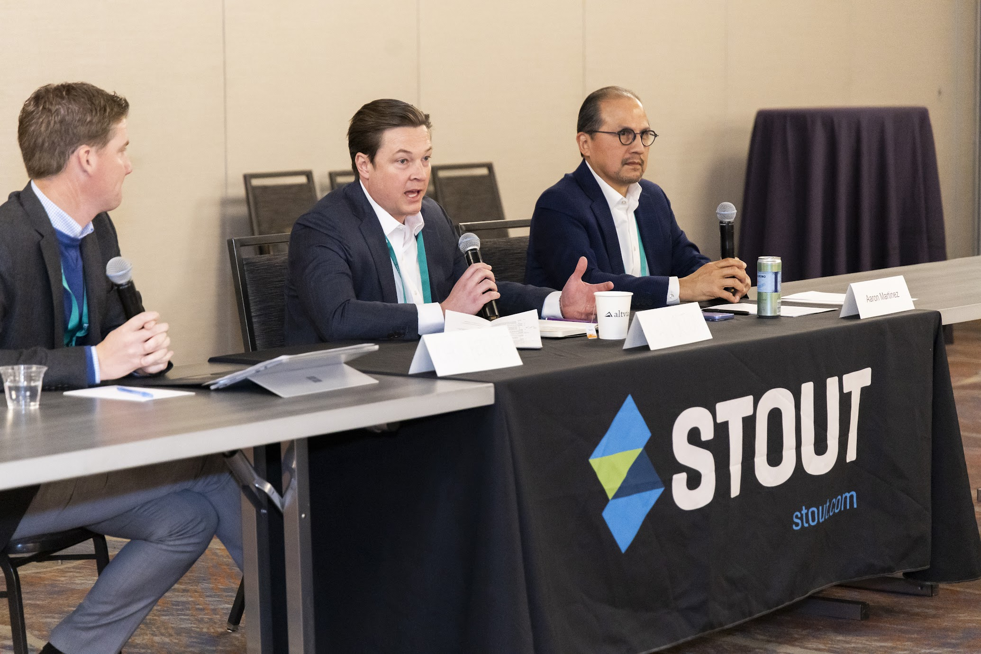
Corporate Development Officer
Roundtable: $8,500
Invitation Only
Number of sponsors: One Exclusive THANK YOU, Stout!
SOLD
Benefits:
Input on Topic and Speakers (opportunity to introduce or moderate)
Exhibitor Table in room with company materials
5 complimentary Conference Registrations ($4,375 value)
Public acknowledgement of sponsorship at podium
Special Early Bird Member Pricing for additional guest registrations ($575 vs. $875 regular, non-member)
Logo and hyperlink on Conference website pages
Share company thought leadership in monthly newsletter (circ. 10K)

Slide 9
SOLD
ACG Access
Meeting Scheduler: $7,500
Number of sponsors: One Exclusive THANK YOU, KSM!
Benefits:
Sponsor logo on ACG Access meeting platform app and website
Premier placement of Sponsor Exhibitor Table
4 complimentary Conference Registrations ($3,500 value)
Special Early Bird Member Pricing for additional guest registrations ($575 vs. $875 regular, non-member)
Logo and hyperlink on Conference website pages
Share company thought leadership in monthly newsletter (circ. 10K)

Slide 10
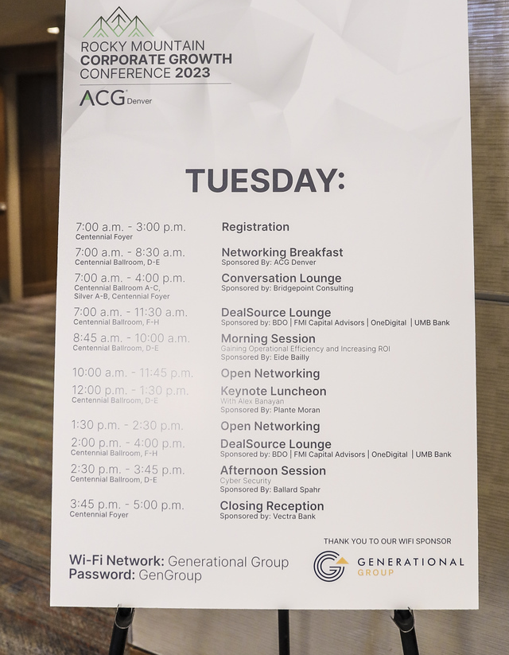
Wi-Fi: $5,500
Number of sponsors: One Exclusive THANK YOU, Silverview Credit Partners!
SOLD
Benefits:
Prominent logo recognition in Wi-Fi address and Wi-Fi signage
Sponsor Exhibitor Table
3 complimentary conference registrations ($2,625 value)
Special Early Bird Member Pricing for additional guest registrations ($575 vs. $875 regular, non-member)
Logo and hyperlink on Conference website pages

Slide 11
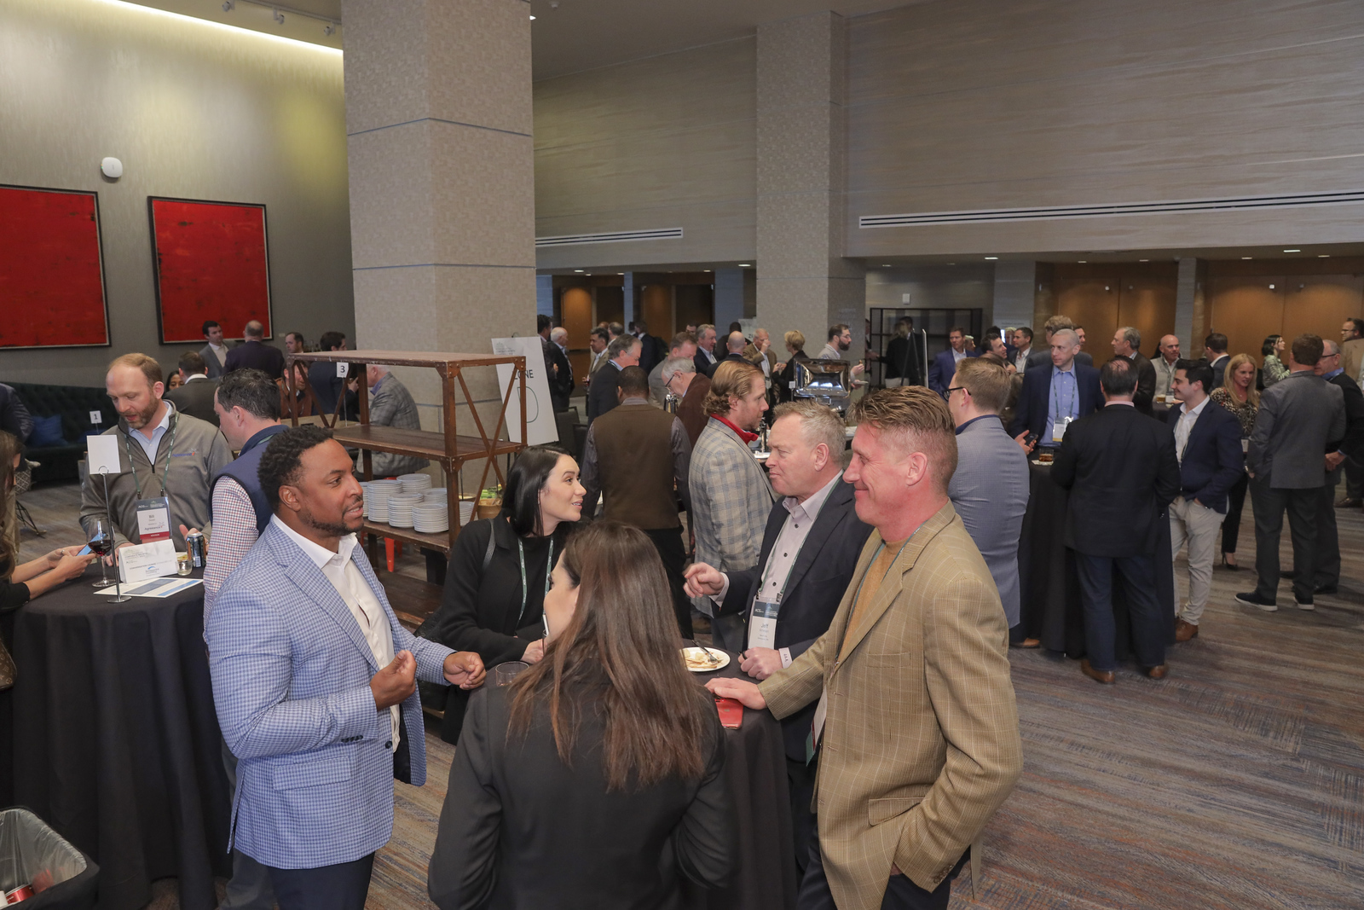
Main Reception: $5,000
Number of sponsors: Up to 4 sponsors
Benefits:
Logo prominence at Monday evening event
Sponsor Exhibitor Table
3 complimentary conference registrations ($2,625 value)
Public acknowledgement of sponsorship at podium
Special Early Bird Member Pricing for additional guest registrations ($575 vs. $875 regular, non-member)
Logo and hyperlink on Conference website pages

Slide 12
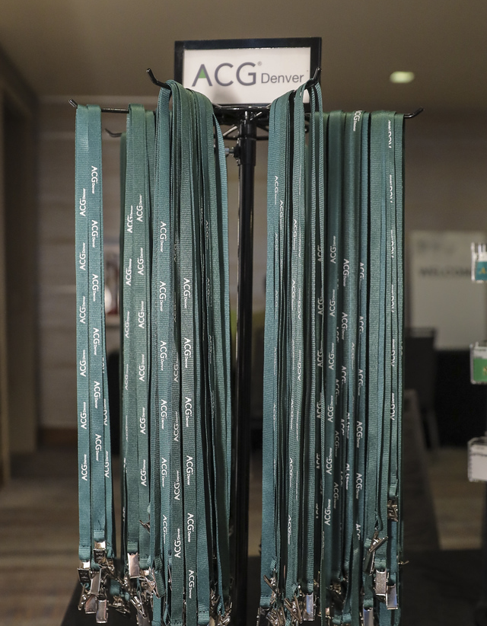
Lanyards: $5,000
Number of sponsors: Up to 2 @ $5,000 THANK YOU, LCG Advisors!
1 SOLD
Benefits:
Prominent logo recognition displayed on name badge lanyards
Sponsor Exhibitor Table
3 complimentary Conference Registrations ($2,625 value)
Public acknowledgement of sponsorship at podium
Special Early Bird Member Pricing for additional guest registrations ($575 vs. $875 regular, non-member)
Logo and hyperlink on Conference website pages

Slide 13
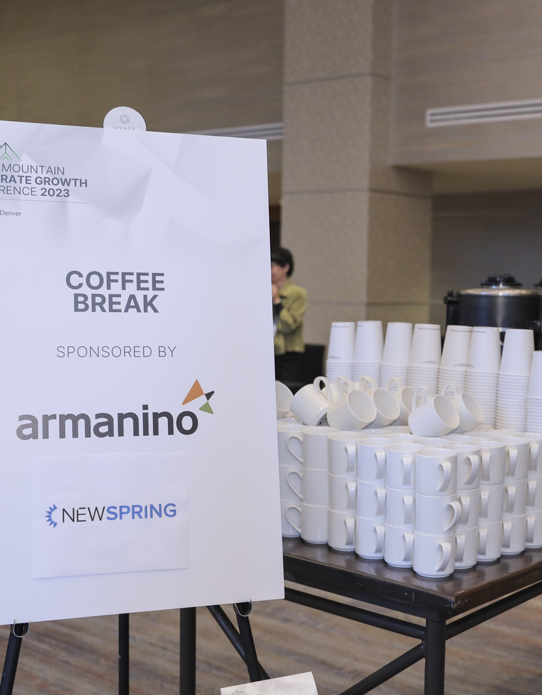
1 SOLD
Coffee Bar & Snacks: $5,000
Number of sponsors: Up to 2 @ $5,000 or One Exclusive @ $9,800
THANK YOU, Taft!
Benefits:
Prominent logo recognition display at coffee stations
Sponsor Exhibitor Table
3 complimentary Conference Registrations ($2,625 value)
Public acknowledgement of sponsorship at podium
Special Early Bird Member Pricing for additional guest registrations ($575 vs. $875 regular, non-member)
Logo on and hyperlink Conference website pages for one year
Share company thought leadership in monthly newsletter (circ. 10K)

Slide 14
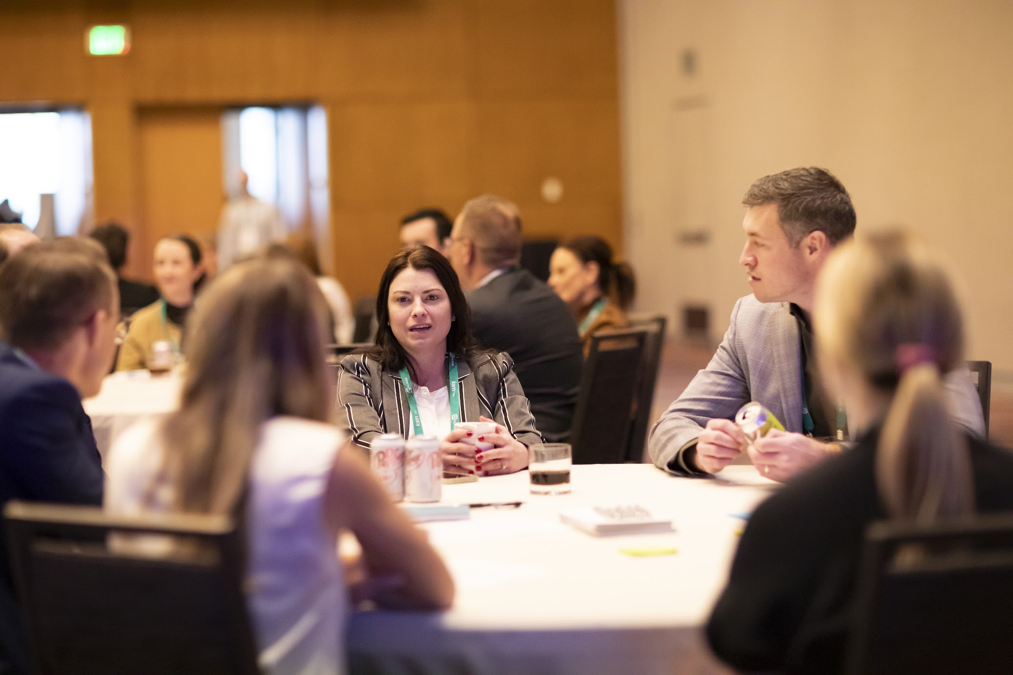
1 SOLD
Powerful Connections
Lunch: $5,000
Hosted by ACG Denver Women’s Network
Number of sponsors: Up to 2 @ $5,000 or One Exclusive @ $9,800 THANK YOU, Comerica!
Benefits:
Opportunity for Podium Visibility (introduce speaker or moderate or provide closing remarks)
Opportunity to join Content Planning Committee (if commit prior to Sept. 1)
Sponsor Exhibitor Table
3 Complimentary Conference Registrations ($2,625 value)
Special Early Bird Member Pricing for additional guest registrations ($575 vs. $875 regular, non-member)
Logo and hyperlink on Conference website pages
Share company thought leadership in monthly newsletter (circ. 10K)

Slide 15
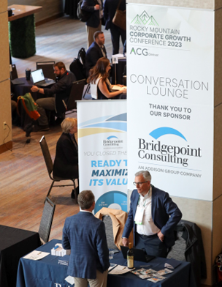
Conversation Lounge: $5,000
Number of sponsors: Up to 4 sponsors
Benefits:
Prominent logo recognition display at each conversation pod (consist of groupings of 2 or more seats, including charging stations) for private conversation
Sponsor Exhibitor Table
3 complimentary conference registrations ($2,625 value)
Special Early Bird Member Pricing for additional guest registrations ($575 vs. $875 regular, non-member)
Logo and hyperlink on Conference website pages
Share company thought leadership in monthly newsletter (circ. 10K)

Slide 16
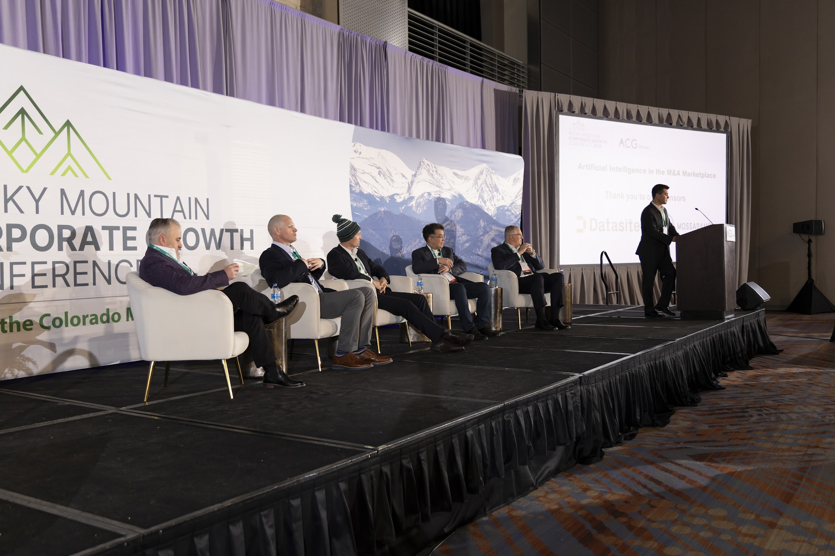
1 SOLD
Morning Session: $5,000
Number of sponsors: Up to 2 sponsors THANK YOU, Pandoblox!
Benefits:
Opportunity introduce or moderate Tuesday Morning session if appropriate to the topic
Opportunity to join content planning committee (if commit prior to Sept 1)
One reserved table at Morning Session (8-seat round)
Sponsor Exhibitor Table
3 complimentary Conference Registrations ($2,625 value)
Special Early Bird Member Pricing for additional guest registrations ($575 vs. $875 regular, non-member)
Logo and hyperlink on Conference website pages
Share company thought leadership in monthly newsletter (circ. 10K)

Slide 17
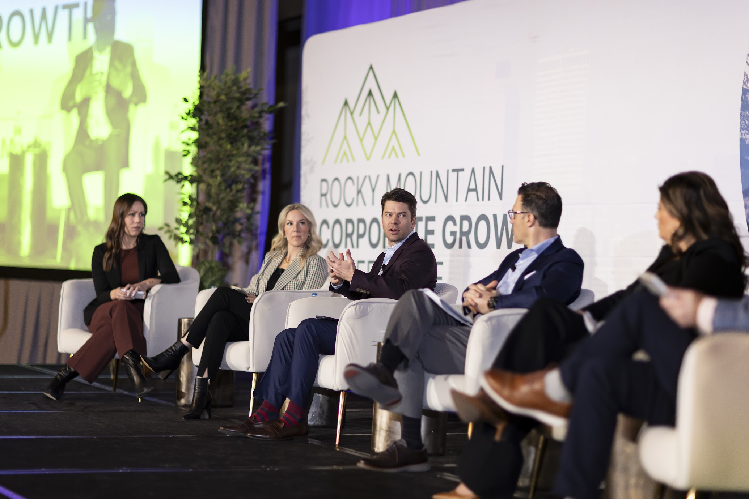
Afternoon Session: $5,000
Number of sponsors: Up to 2 sponsors THANK YOU, Baker Tilly!
1 SOLD
Benefits:
Opportunity introduce or moderate Monday afternoon session if appropriate to the topic
Opportunity to join content planning committee (if commit prior to Sept 1)
One reserved table at Morning Session (8-seat round)
Sponsor Exhibitor Table
3 complimentary Conference Registrations ($2,625 value)
Special Early Bird Member Pricing for additional guest registrations ($575 vs. $875 regular, non-member)
Logo and hyperlink on Conference website pages

Slide 18

1 SOLD
Quick Knowledge Bites: $4,500
20-minute sessions
Number of sponsors: One sponsor per session (up to 6 sessions offered)
THANK YOU, BDO!
Benefits:
Exclusive presentation of topic to an audience of approximately 25+
Topic selection with RMCGC Content Planning Committee approval
Sponsor Exhibitor Table
2 complimentary conference registrations ($1,750 value)
Special Early Bird Member Pricing for additional guest registrations ($575 vs. $875 regular, non-member)
Logo and hyperlink on Conference website pages

Slide 19
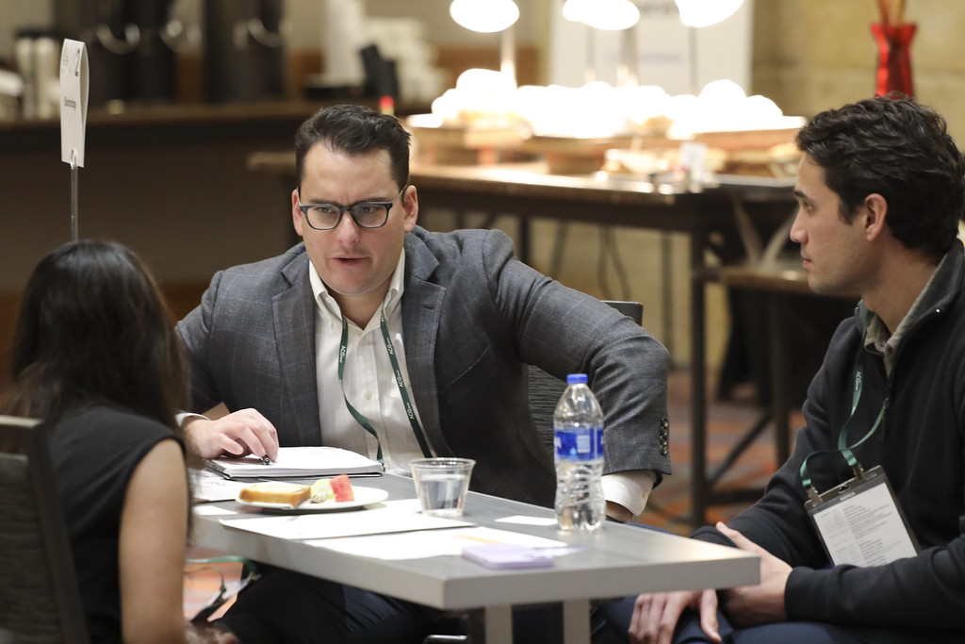
1 SOLD
Benefits:
Covers up to 3 C-level company owners, founders and operator registrations
Input on middle market company executive invitations
Logo on invitational emails to middle-market company owners, founders and operators
1 complimentary Conference Registration
Special Early Bird Member Pricing for additional guest registrations ($575 vs. $875 regular, non-member)
Logo and hyperlink on Conference website pages
C-Level Host: $3,500
Invitation Only THANK YOU, Vectra!

Slide 20
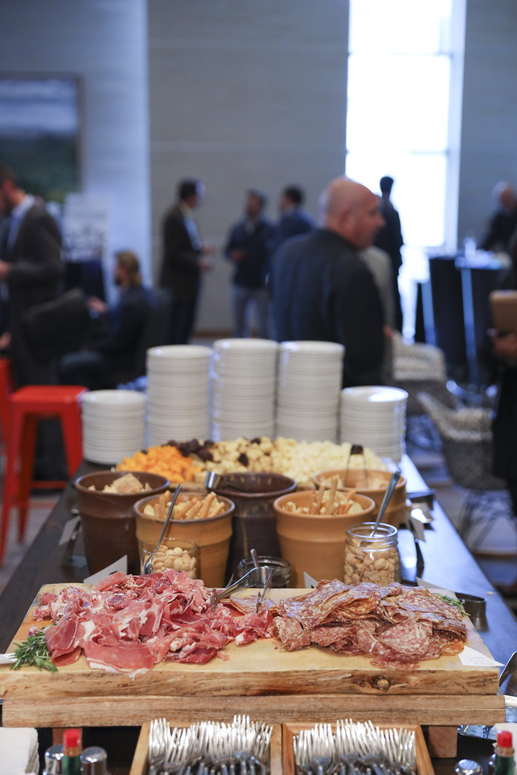
Closing Reception: $2,500
Number of sponsors: Up to 2 sponsors
Benefits:
1 complimentary conference registration
Special Early Bird Member Pricing for additional guest registrations ($575 vs. $875 regular, non-member)
Logo and hyperlink on Conference website pages

Slide 21
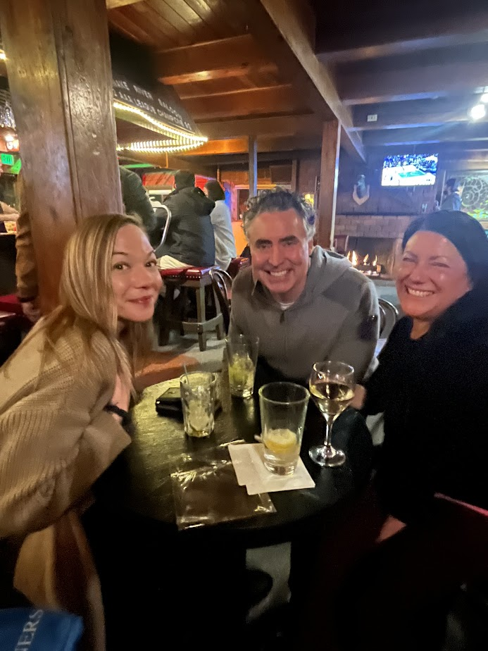
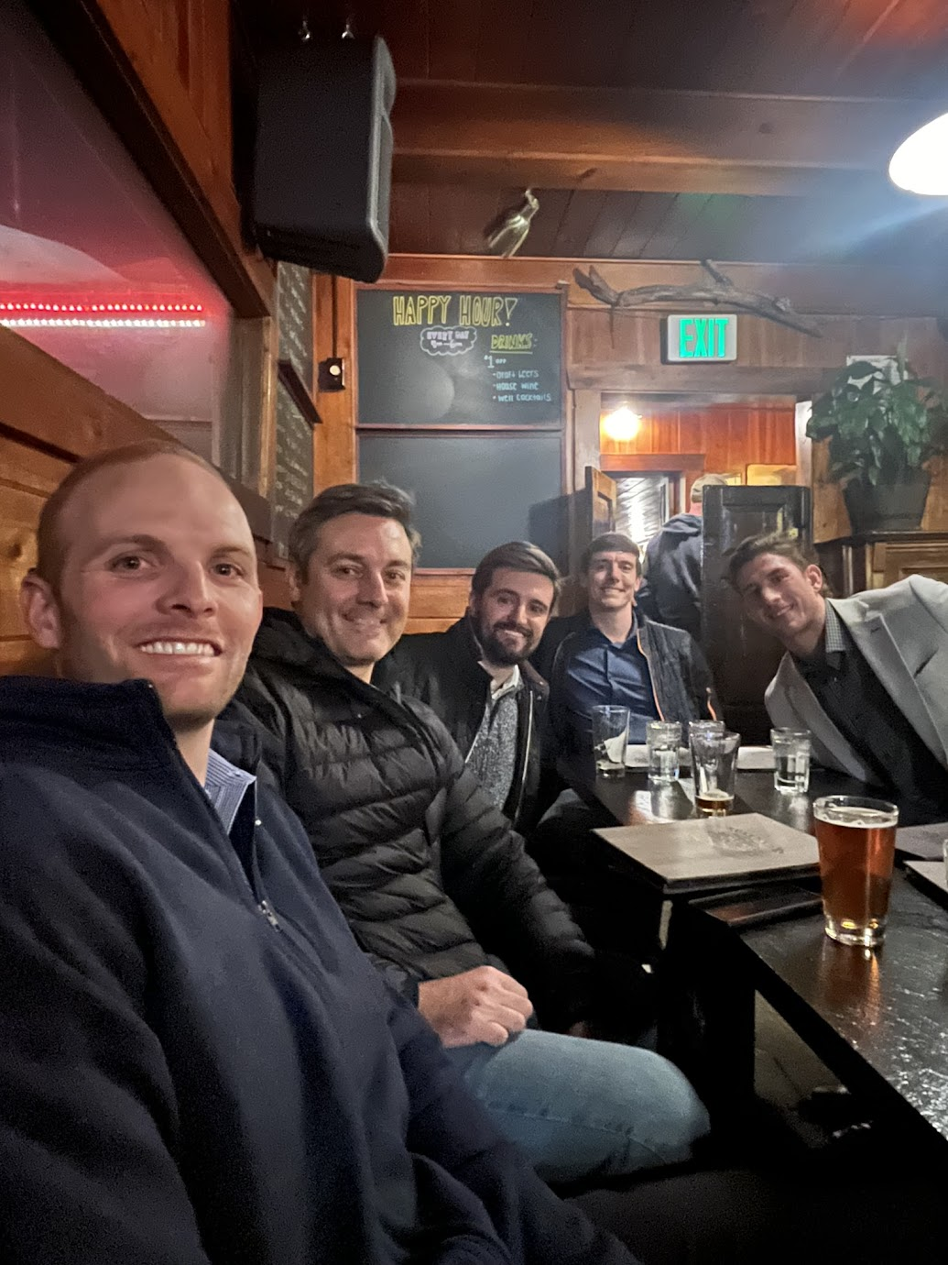
Pre-Ski Happy Hour: $2,500
Number of sponsors: Up to 2 sponsors THANK YOU, FMI Capital!
1 SOLD
Benefits:
1 complimentary conference registration
Special Early Bird Member Pricing for additional guest registrations ($575 vs. $875 regular, non-member)
Logo and hyperlink on Conference website pages

Slide 22
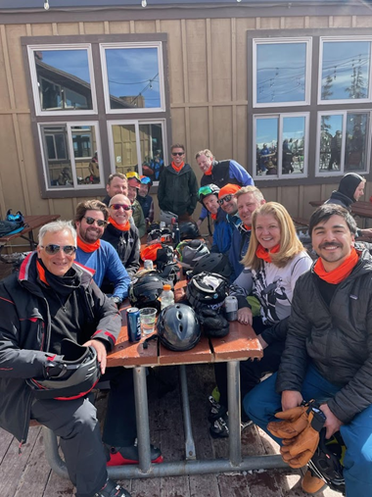
1 SOLD
Ski Gaiters: $750
Number of sponsors: Up to 2 sponsors THANK YOU, Pierson Ferdinand!
Benefit:
Logo on Ski Gaiters worn during post-conference Ski Networking event
1 complimentary Ski Event Registration

Slide 23

Conference Schedule*
Sunday, February 8 | Schedule*
Time | Session
4:30 - 7:00 pm | Superbowl Sunday Meetup
Monday, February 9
Time | Session
9:00 AM - 3:00 PM | Conversation Lounge
9:00 AM - 12:00 PM | DealSource Lounge
10:30 - 11:30 am | Quick Knowledge Bites (Two - 20 min sessions): 10:30-10:50 am/11:00 to 11:20 am
12 NOON - 1:20 PM | Keynote Luncheon
1:30 - 2:30 PM | Corporate Development Officers Roundtable (Invitation only)
1:30 - 3:30 pm | DealSource Lounge
1:30 - 2:30 pm | Quick Knowledge Bites (Two - 20 min sessions) 1:30 - 1:50 pm/2:00 - 2:20 pm
2:30 -3:30 pm | Afternoon Session
3:30 - 5:00 PM | Capital Connection Opening Reception (All)
4:30 -5:30 PM | Capital Connection Reception PE/IB Hour (Private Equity & Investment Banks By Invitation Only)
Tuesday, February 10
Time | Session
7:00 AM - 3:00 PM | Registration
7:00 AM - 3:30 PM | Conversation Lounge
7:00 - 3:00 PM | DealSource Lounge
9:00 - 10:00 AM | Morning Session
10:30 - 11:30 am | Quick Knowledge Bites (Two - 20 min sessions) 10:30-10:50 am/11:00 to 11:20 am
11:30 AM - 12:45 PM | Powerful Connections Lunch hosted by Women's Network
2:30 - 3:30 PM | Closing Reception
6:30-8:00 pm | Pre-Ski Event Happy Hour
Wednesday, February 11
Time | Session
8:00 AM | Post-Conference Ski Event
*Subject to change

Slide 24
Sponsorship Commitment
2025 sponsors are given the first right of refusal for 2026 sponsorship through September 1, 2026.
All invoices are Net 30 unless specific arrangements are made.
To reserve your sponsorship, please contact Veronica Munoz at vmunoz@acg.org.
No benefits other than those stated in the prospectus are implied or promised.

