Slide 1
Outlook for the U.S. and
Florida
October 25, 2017
Association for Corporate Growth
Hank Fishkind
Fishkind & Associates, Inc.
12051 Corporate Boulevard
Orlando, Florida 32817

Slide 2
Factors Shaping U.S. Outlook
How much momentum?
Impact of structural change?
New economic policies?
Policies on trade and immigration?
When will higher interest rates slow growth?
Will the labor market overheat?

Slide 3
Yogi Berra observed, it’s tough to make predictions, especially about the future

Slide 4
U.S. Forecast Summary 2017 – 2020
Current status +/- 3% GDP growth
  Positive forces:
    Strong gains in jobs and rising wages
    Low interest rates, oil prices and inflation
    AI and big data
  Negative forces:
    Structural change without proper policy response
Monetary policy – the shift to normal rates
Trump’s fiscal policies will boost growth and interest rates in 2018
  Big tax cuts for corporations and households
  Higher defense spending
  Reduced regulations
  Big unknowns are healthcare, immigration and trade policies
Boom in 2018-19 then higher rates and recession
Main forecasts risk: (1) fiscal policies under Trump, (2) Geopolitical risks, and (3) effects of higher interest rates

Slide 5
Florida Summary
Strong cyclical upswing underway
  Sustained job growth lead by tourism and healthcare
  Population growth stronger then expected
  Impact from Puerto Rico
Recovery is accelerating, and it will be above average recovery by Florida standards by 2018
  515,000 population growth
  255,000 new jobs
  135,000 housing starts
Geographic focus of growth shifted and tightened

Slide 6
How much momentum?

Slide 7
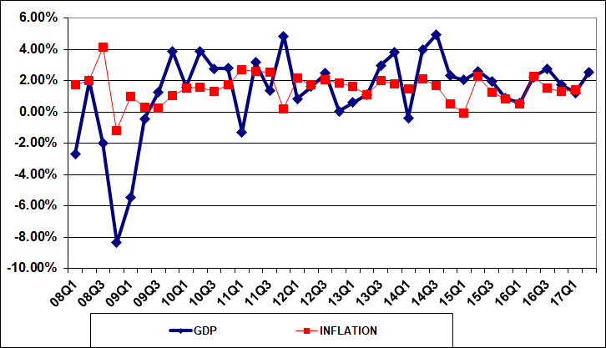
RECENT TRENDS IN GDP AND INFLATION

Slide 8
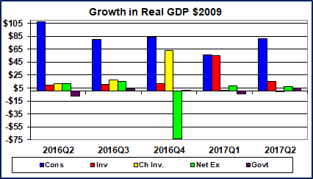

Slide 9
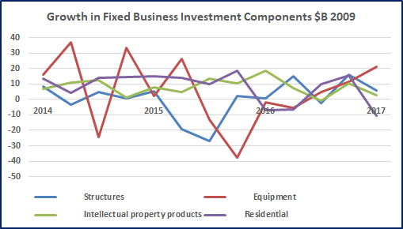

Slide 10
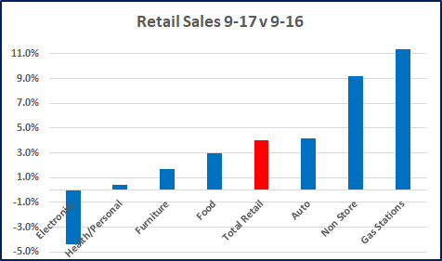

Slide 11
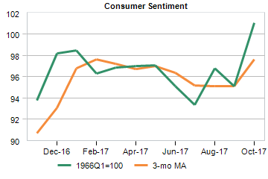

Slide 12
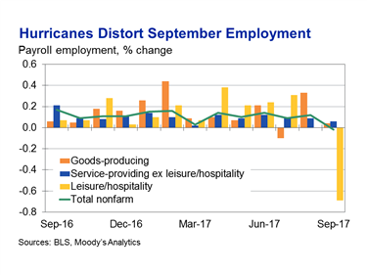

Slide 13
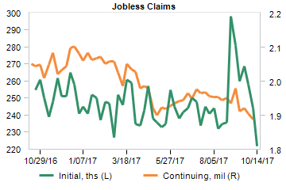

Slide 14
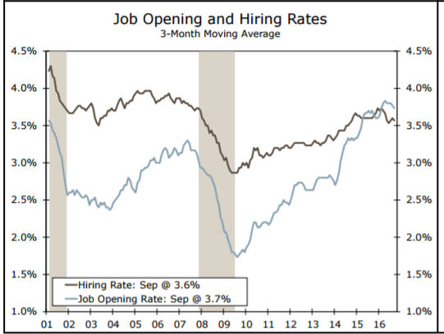

Slide 15
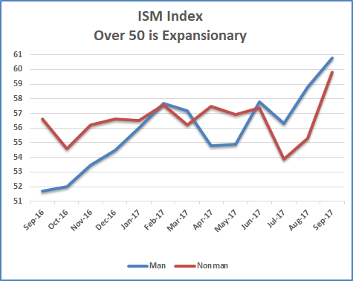

Slide 16
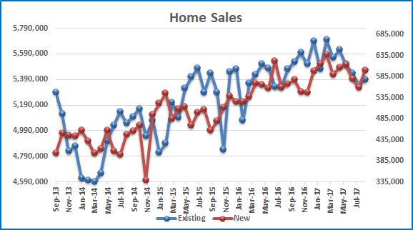

Slide 17
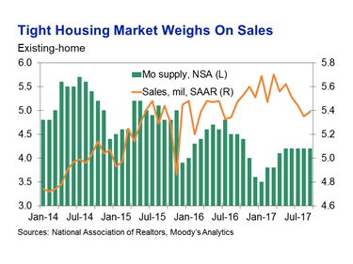

Slide 18
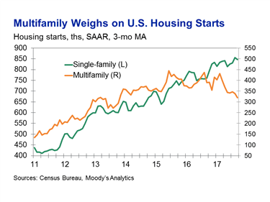

Slide 19
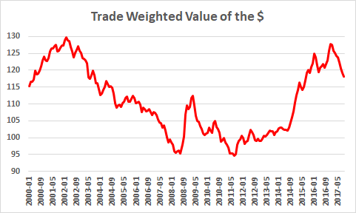

Slide 20
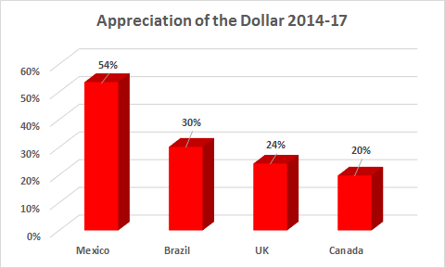

Slide 21
Structural change

Slide 22
Structural Change
AI and Automation
Globalization
Immigration
Income inequality
Impact on real estate development
  Less demand for space
  Retail and office in particular
Climate Change and Current Impacts

Slide 23
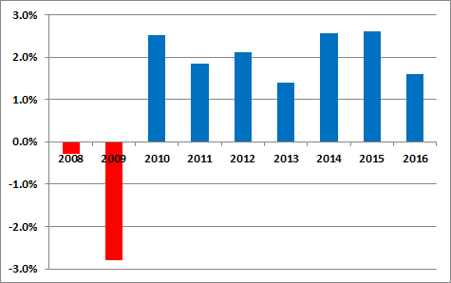
Low Growth Trajectory for Real GDP
Fallout from Great Recession
  Increased regulation
  Lower risk tolerance
Globalization
  Holds down prices
  Holds down wages
Income Inequality
Underestimate GDP
  Investment in Tech
  Consumption Social Media
Current mix of monetary and fiscal
Policies yields +/- 2% Growth GDP

Slide 24
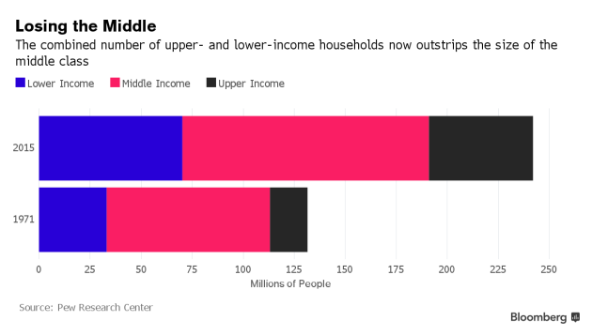

Slide 25
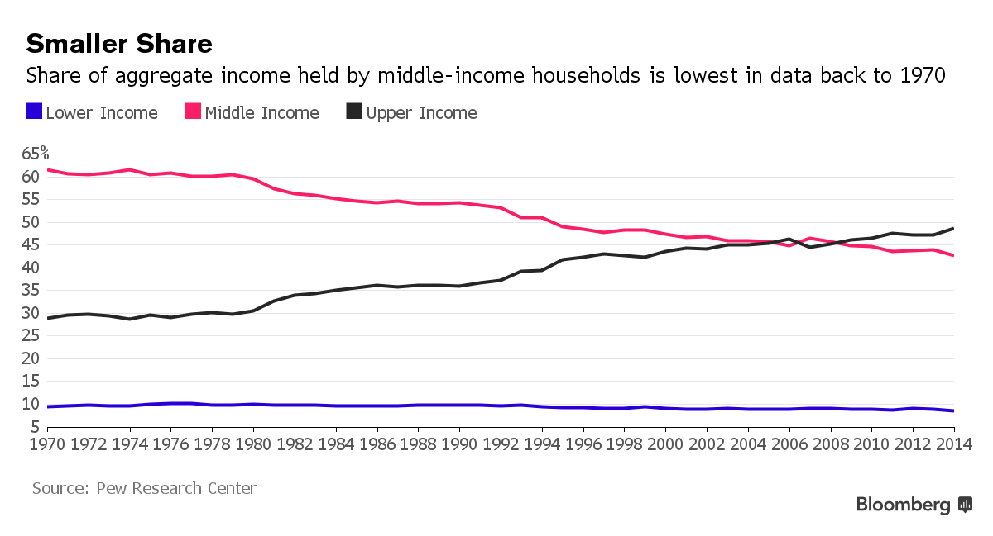

Slide 26
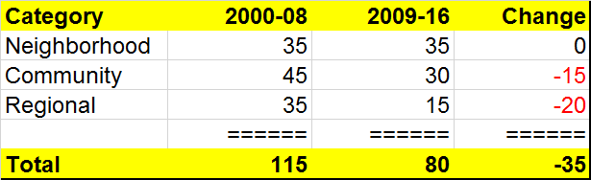
Structural Change, Retail Sales and Store Space
Major structural changes in retail sales
  Historic shift to ecommerce
  Change in composition of sales: less goods and more services
Impact on store space requirements

Slide 27
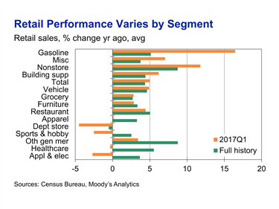
Retail Sales Variations
Retail sales up 5% YOY
Weak sectors
  Department & general merchandise, appliances and apparel
  10 bankruptcies including Payless ShoeSource, Limited Stores, HHGregg and Wet Seal
Strong Sectors too

Slide 28
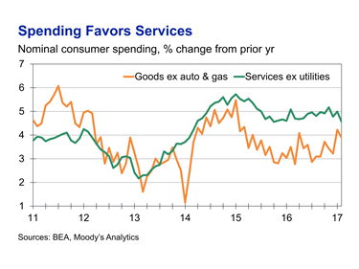

Slide 29
Economic Policy Issues in a World of Structural Change
Transformational forces
  Globalization/Trade
  Automation/Artificial Intelligence
  Migration
Slow economic growth / low demand
Distributional issues for those left behind / political & economic issues
Debt and structural issues in the budget

Slide 30
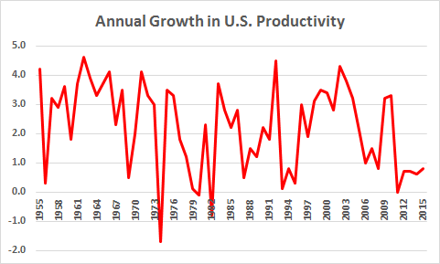
Long Term Economic Growth
% GDP = % Productivity + % Population
1.8% to 1.75% GDP
  0.8% to 1.5% productivity
  1% to 1.25% population
Investment in human & physical capital
Reform entitlements and healthcare
Revise immigration policy

Slide 31
Current Impacts of Climate Change on Florida
Increased frequency and intensity of tropical cyclones
Increased “nuisance” flooding monthly in Miami Beach and the Keys
Rising sea level and beach erosion
Algal blooms and invasive plants/bugs
Migration from Puerto Rico >500,000

Slide 32
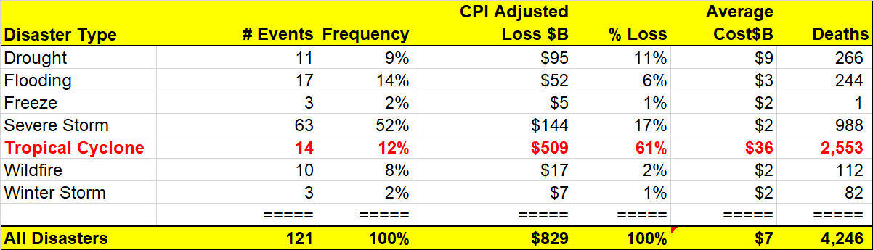
$Billion Events Impacting the U.S. from 2005-2017
Source: NOAA National Centers for Environmental Information (NCEI) U.S. Billion-Dollar Weather and Climate Disasters (2017). https://www.ncdc.noaa.gov/billions/
Florida subject to hurricanes which are the most damaging of events

Slide 33
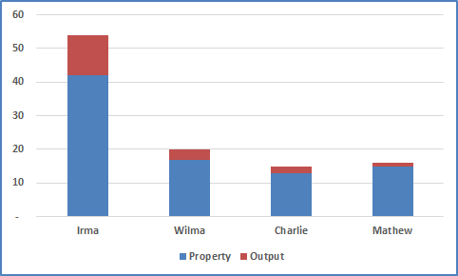
Damage from Recent Florida Hurricanes

Slide 34
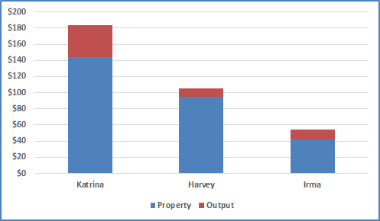
2017 Hurricanes in Perspective

Slide 35
Forecast

Slide 36
Trump Fiscal Policy
Affordable Care Act - delayed
Major fiscal stimulus - Maybe
  Tax cuts for corporations and households appears likely
  Increased spending for defense no infrastructure package
Major unresolved issues remain
  Debt ceiling
  Structural budget deficit
Major unknowns and risks
  Foreign trade
  Immigration

Slide 37
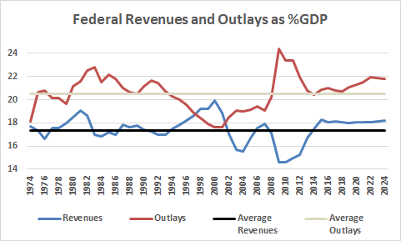
Average Outlays
Average Revenues

Slide 38
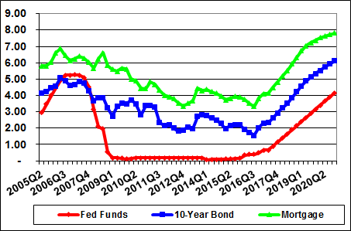
INTEREST RATES

Slide 39
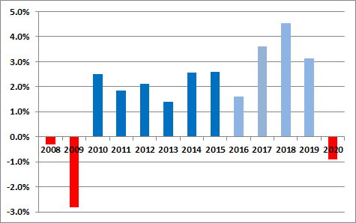
GDP Growth
(Percent growth SAAR)

Slide 40
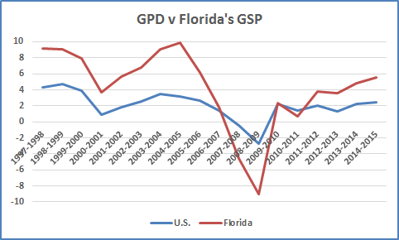
Correlation 0.88

Slide 41
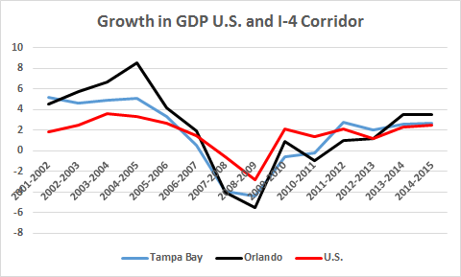
Correlations with U.S. GDP
Orlando | 0.90
Tampa | 0.86

Slide 42
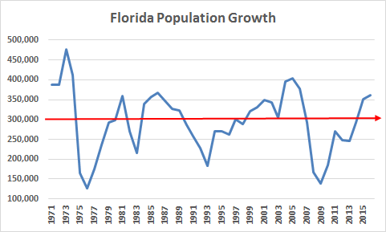
Average

Slide 43
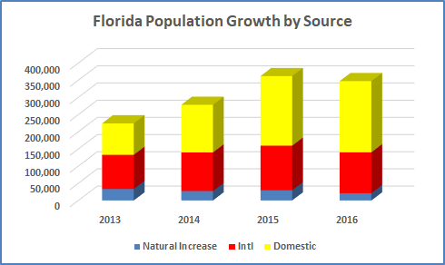

Slide 44
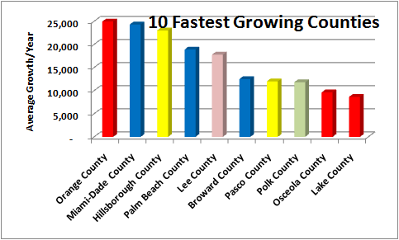

Slide 45
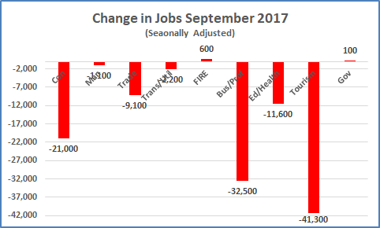

Slide 46
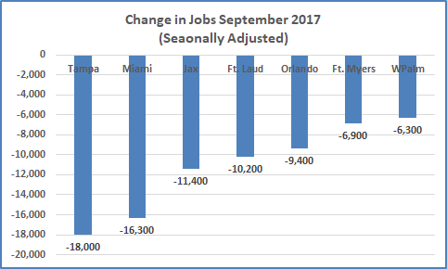

Slide 47
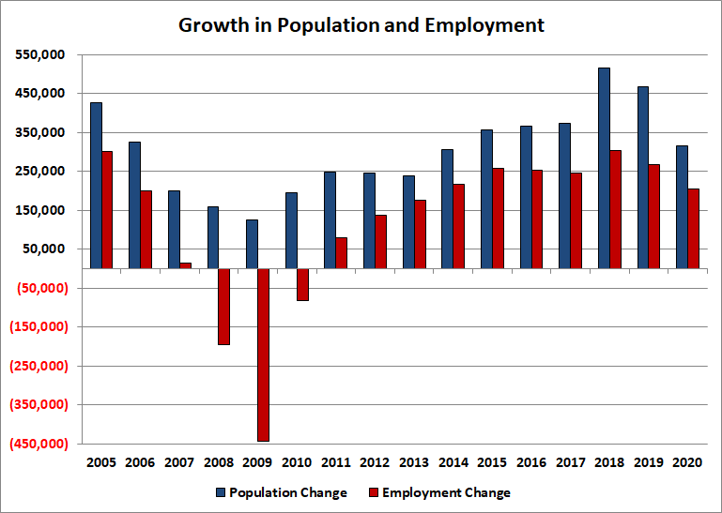

Slide 48
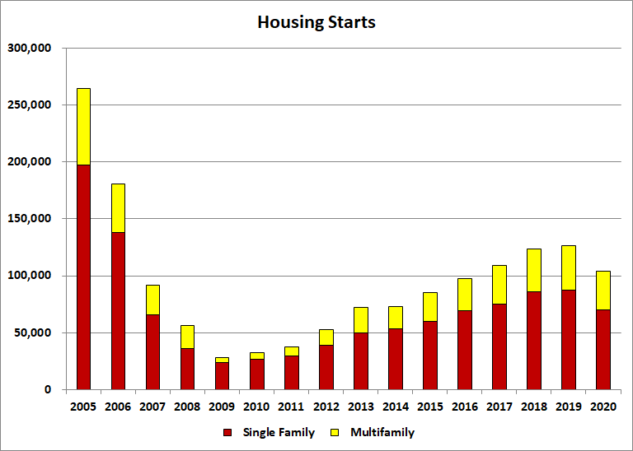

Slide 49
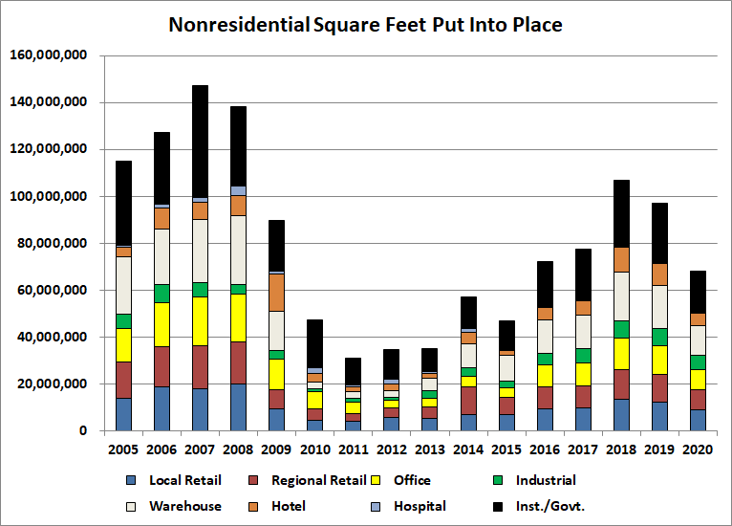

Slide 50
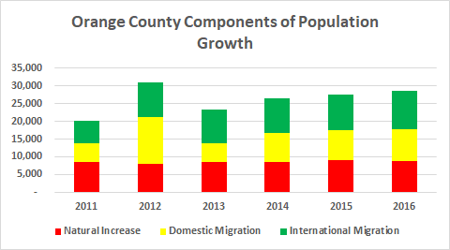

Slide 51
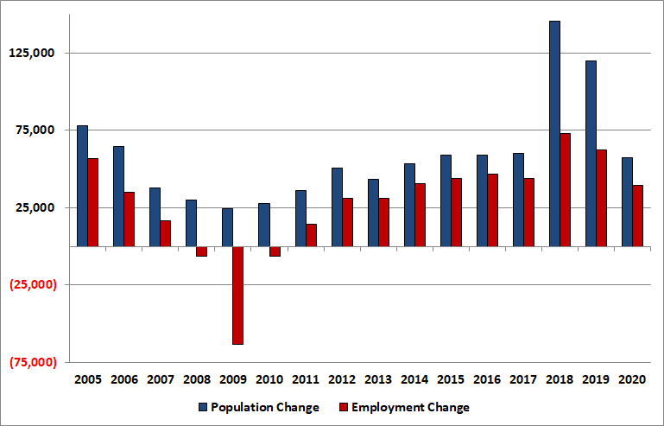
Orlando MSA Growth
Population and Employment

Slide 52
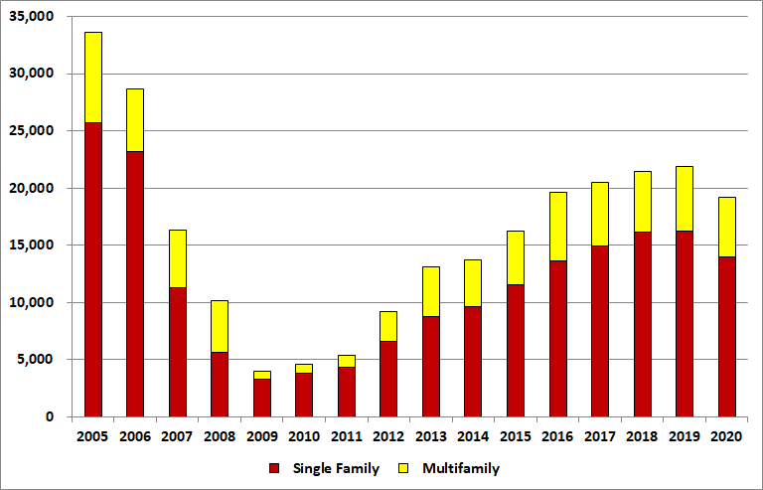
Orlando MSA
Housing Starts

Slide 53
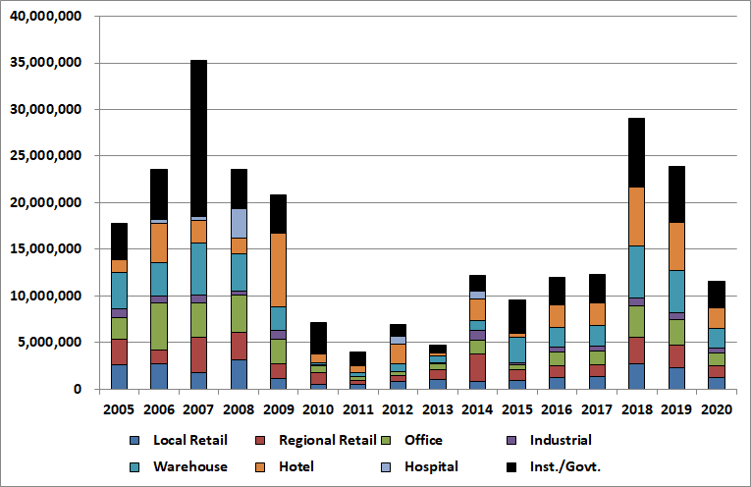
Orlando MSA
Non Residential Construction

Slide 54

The End

