Slide 1
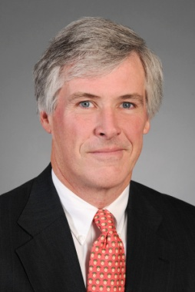
Biographies
Jeremiah W. Doyle, IV
Estate Planning Strategist
Senior Vice President, BNY Mellon Wealth Management
Jere Doyle is an estate planning strategist for BNY Mellon Wealth Management and a senior vice president of BNY Mellon. He has been with the firm since 1981. Jere provides wealthy individuals and families throughout the country with integrated wealth management advice on how to hold, manage, and transfer their wealth in a tax efficient manner.
Memberships
Former member, Massachusetts Joint Bar Committee on Judicial Appointments
Member, American Bar Association
Member, Massachusetts Bar Association
Member, Essex County Bar Association
Member, Boston Estate Planning Council
Former president, Boston Estate Planning Council
Executive committee member, Boston Estate Planning Council
20-year member, Essex County Bar Association Executive Committee
Notices, Publications & Awards
2009 Estate Planner of the Year, Boston Estate Planning Council
Co-Author, The Income Taxation of Trusts and Estates, law school casebook published by Carolina Academic Press (2019)
Editor and co-author, Preparing Fiduciary Income Tax Returns
Contributing Author, Preparing Estate Tax Returns
Contributing Author, Understanding and Using Trusts and contributing author of Drafting Irrevocable Trusts in Massachusetts, both published by Massachusetts Continuing Legal Education
Quoted in numerous business publications and has appeared as an expert on wealth management issues on CNBC, MSNBC, and CNN
Estate Planning Hall of Fame®, National Association of Estate Planners and Councils
Distinguished Accredited Estate Planner®, National Association of Estate Planners and Councils, Adjunct Professor of Law, Boston University Law School, Graduate Tax Program
Education
LL.M., banking law, Boston University Law School
LL.M., taxation, Boston University Law School
Juris Doctor, Hamline University Law School
Bachelor’s degree, Providence College
Bar and Court Admissions
Commonwealth of Massachusetts
United States District Court
United States Court of Appeals (First Circuit)
United States Tax Court

